Slide 1
API-driven Cloud Native Solutions
Notes:
Hello everyone!

Slide 2
Course Name - API-driven Cloud Native Solutions
Course Number - CC ZG506
Units - 5

Slide 3
Instructor Profile
Prof.Animesh Giri
16+ Years of Experience in IT, Teaching and Research.
Guest Faculty at BITS – Pilani – WILP since 2018.
Full-time working as Associate Professor & Placement Coordinator at CSE dept at a reputed university at Bangalore since 2011
B.E – ISE from VTU, M.Tech in Computer Network Engineering from VTU, (PhD) from VTU.
Worked as Software Engineering at KEANE INDIA PVT LTD for 3 Years.
Have 40+ Publications in Journals , IEEE / Springer Conference Proceedings.
LinkedIn: https://www.linkedin.com/in/animesh-giri-15272531/
Google Scholar: https://scholar.google.co.in/citations?user=7q3inAcAAAAJ&hl=en

Slide 4
Instructor Profile
Courses I teach at BITS
Computer Networks
Advanced Computer Networks
Wireless and Mobile Communications
Data Storage Technologies and Networks
Blockchain Technologies and Systems
Distributed Computing
Automotive Networking
Network Security
Software Architectures
API-driven Cloud Native Solutions

Slide 5
Student Profile
Name
Role in Organization (Ex: Developer, Tester, Architect etc.)
Years of Experience
Exposure to Cloud Native development? Yes / No (If yes, mention Cloud name)
Exposure to API-based development? Yes / No

Slide 6
Walkthrough of Course Handout

Slide 7

Course Description
Analyze, Design, Develop and Deploy cloud native applications in innovative areas such as Data Science, Artificial Intelligence/Machine Learning (AI/ML), IoT, Data Analytics etc.;
Build an end to end complex application; Extensive usage of well-known PaaS/APIs;
Demonstration of compliance with relevant, industry adapted best practices;
Deployment using modern strategies; Presentation of the Milestones and outcomes in appropriate forms;
Periodic review of progress of the project by faculty.

Slide 8

Course Objectives
No | Objective
CO1 | Explain the fundamentals of APIs, including RESTful and GraphQL APIs, and demonstrate how to design, specify, and implement API versioning
CO2 | Identify the key components of the cloud-native ecosystem such as DevOps, microservices, containers, and serverless computing
CO3 | Apply APIs and relevant tools to execute end-to-end data science and machine learning projects
CO4 | Design AI assistants using APIs for use cases in natural language processing, speech recognition, and computer vision, and construct generative AI assistants using the RAG approach based on suitable language models
CO5 | Develop and deploy end-to-end IoT and data analytics projects using APIs, serverless functions, and containers

Slide 9

Module Structure
Module | Description
0 | Python Programming [Self-Study]
1 | API Basics
2 | Cloud Native Application
3 | Data Science and Machine Learning
4 | AI and Cognitive Services Part A: Basic APIs for AI applications Part B: Language Models Part C: Cloud Native Application Deployment
5 | IoT and Data Analytics

Slide 10
Contact Session wise Coverage
Session | Coverage
CS01 | API Basics (OpenAPI, REST, gRPC, GraphQL)
CS02 | API Basics + Cloud Native Application
CS03 | Cloud Native Application
CS04 | Introduction to Data Science & Machine Learning and Lifecycles
CS05 | API driven Cloud-native Data Pipeline
CS06 | API-driven ML pipelines
CS07 | Tools review; Case Study
CS08 | Basic APIs for AI Applications – NLP, CV, Speech recognition
CS09 | Language Models (LLMs)
CS10 | RAG Models
CS11 | RAG Models
CS12 | Cloud Native Application Deployment
CS13 | IoT and Data Analytics
CS14 | APIs for IoT and Data Analytics
CS15 | Serverless Functions; Case study
CS16 | Course review and discussion

Slide 11
Experiential Learning
Lab. No | Module No. | Session No. | Experiment | Tools list (Indicative only)
1 | 3 | 5 | Demonstrate the design and development of API-based data pipeline which involves data ingestion, pre-processing, analysis and monitoring activities | Prefect, AirFlow
2 | 3 | 7 | Demonstrate the design and development of Machine Learning pipeline which involves model development, training, deployment and monitoring activities | AWS SageMaker, MLFlow
3 | 4 | 8 | Demonstrate NLP tasks such as speech processing, language translation, text summarization, and text generation using Cloud-based APIs | HuggingFace APIs and / or AWS APIs or Azure APIs or GCP APIs
4 | 4 | 11 | Demonstrate a generative AI assistant, using RAG approach, which answers queries about an application (chatbot) | https://flowiseai.com/ LangChain LangSmith LangFuse Python code to invoke APIs
5 | 5 | 14 or 15 | Demonstrate an IoT and Data Analytics application using Serverless functions | AWS Lambda AWS IoT APIs

Slide 12
Evaluation
Evaluation Component | Name | Type | Weight | Duration
EC – 1 | Quiz I | Online | 5%
 | Assignment I | Online | 15%
 | Assignment II | Online | 15%
EC – 2 | Mid-term Exam | Closed book | 30% | 2 hours
EC – 3 | End Semester Exam | Open book | 35% | 2.5 hours

Slide 13
Information!
All the sessions will be conducted on MS Teams, in online mode.
EC-1 components (Assignments) will be administered on the Taxila portal.
All the Course Material (Handout, PPTs etc.) will be uploaded on MS Teams.
Announcements will be made on Taxila portal when,
Assignment(s) are administered
Rescheduling or Cancellation of class (if any)
To notify the Syllabus for Mid-Sem and Comprehensive exams
To upload the Scheme and Solution documents for Mid-sem and Comprehensive exams.
5. Email for correspondence – animesh.giri@wilp.bits-pilani.ac.in
[Request - Mention the course code / course name in the subject line]

Slide 14
Lecture No. 1

Slide 15
Agenda
API Basics
Introduction to APIs
HTTP APIs
OpenAPI
REST, GraphQL and gRPC based APIs
API Versioning, Semantic versioning
Examples of API - Google Maps API, Rapid API, Conference API etc.
Notes:
API Basics
Introduction to APIs
API stands for Application Programming Interface. It is a set of rules that allows one software application to interact with another. APIs define methods and data structures that applications can use to communicate with each other, enabling different software systems to work together. APIs abstract complexity, allowing developers to interact with software through simple commands.
HTTP APIs
HTTP APIs use the Hypertext Transfer Protocol (HTTP) to communicate between the client (usually a browser or an application) and a server. This is one of the most common types of APIs due to the ubiquity of the web and HTTP as a protocol.
Methods: HTTP APIs primarily operate using the following methods:
GET: Retrieve data from the server.
POST: Submit data to the server.
PUT: Update existing data.
DELETE: Remove data.
Endpoints: APIs are structured around specific endpoints (URLs) where clients send their requests. Each endpoint represents a different resource or function.
OpenAPI
OpenAPI is a standard that defines a language-agnostic interface for RESTful APIs. It allows both humans and machines to understand the capabilities of a service without accessing the source code.
Swagger: OpenAPI specifications can be written in Swagger, which provides a detailed description of API methods, parameters, and responses.
Documentation: OpenAPI ensures that APIs are well-documented and can be automatically integrated into tools that facilitate API management and interaction.
REST, GraphQL, and gRPC based APIs
REST (Representational State Transfer): REST is an architectural style for building APIs. It uses standard HTTP methods and focuses on statelessness, meaning the server does not store any client information between requests. REST is simple and scalable but can sometimes lead to over-fetching or under-fetching of data.
GraphQL: A more flexible alternative to REST, GraphQL allows clients to define exactly what data they need, avoiding the issues of over-fetching and under-fetching. Clients specify the structure of the response, and GraphQL APIs return precisely that.
gRPC (gRPC Remote Procedure Call): gRPC is a high-performance, open-source API framework that uses Protocol Buffers for serialization and works over HTTP/2. It is designed for real-time communication and efficiency in microservices architectures, where speed and message compression are key.
API Versioning and Semantic Versioning
API Versioning: APIs evolve over time, and backward compatibility might be broken as new features or improvements are introduced. Versioning ensures that users are still able to use older versions without issues.
Methods of versioning include using the URL (e.g., /v1/resource) or header versioning.
Semantic Versioning: This versioning strategy follows a three-part numbering scheme: MAJOR.MINOR.PATCH.
MAJOR: Increases when there are incompatible changes.
MINOR: Increases when functionality is added in a backward-compatible manner.
PATCH: Increases when backward-compatible bug fixes are introduced.
Examples of APIs
Google Maps API: Provides various services for embedding maps, geolocation, directions, and distance matrix calculations in applications.
RapidAPI: A marketplace for connecting to thousands of public APIs in various categories like weather, finance, etc.
Conference API: Provides data for managing and retrieving information related to conferences, including speakers, schedules, and venues.
These examples demonstrate how APIs can simplify complex operations and provide functionality to developers without needing to rebuild these features from scratch.

Slide 16
API

Slide 17
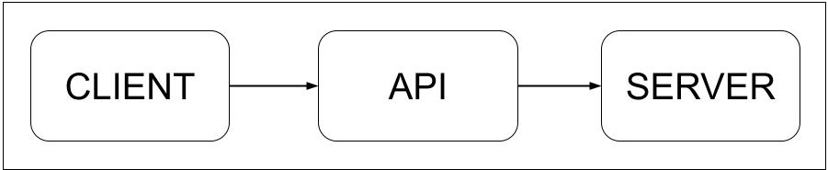
API
Acronym for “Application Programming Interface”
Some definitions
API is a contract between a service and its clients
Set of rules and protocols for building and interacting with software applications. The application will be exposed as set of APIs.
APIs enable different software systems to communicate with each other, allowing for data exchange and functional integration without requiring the end-user to understand the underlying code.
Notes:
API (Application Programming Interface) - Definitions and Explanation
Acronym:
API stands for Application Programming Interface.
Definitions:
API is a contract between a service and its clients:
It defines the precise rules and expectations for how the service and the client will interact, including the specific requests clients can make and the types of responses they will receive.
API as a set of rules and protocols for building and interacting with software applications:
APIs provide structured methods to access functionality or data from an application. Developers use these rules to build, interact, and integrate applications seamlessly. The application exposes a set of APIs to allow for specific interactions.
APIs enable different software systems to communicate with each other:
They allow applications or services to exchange data and perform actions across systems. This interaction happens without requiring users or developers to understand the underlying source code of the systems involved. APIs act as intermediaries that abstract complex logic into simpler commands for clients.
In summary, APIs facilitate functional integration and data exchange across diverse platforms, supporting modular and scalable software architecture.

Slide 18
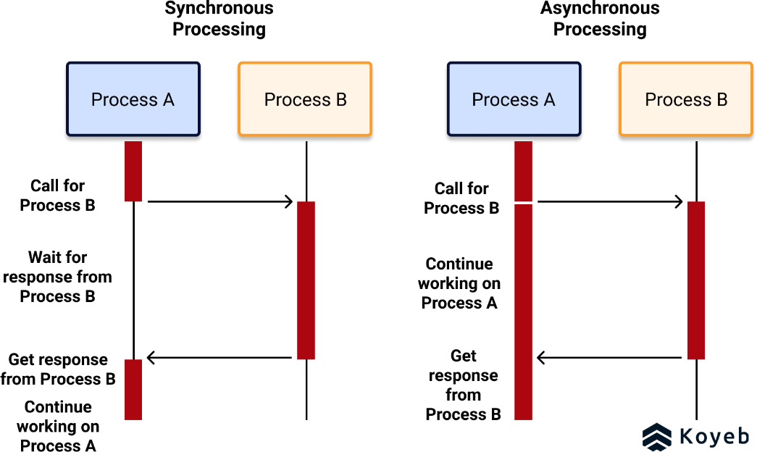
Synchronous vs Asynchronous
Synchronous execution means the first task in a program must finish processing before moving on to executing the next task
Asynchronous execution means a second task can begin executing in parallel, without waiting for an earlier task to finish.
Notes:
Synchronous vs. Asynchronous Execution
Synchronous Execution:
In synchronous execution, tasks are processed one after the other, in a sequential manner.
The first task in the program must finish completely before the next task can begin.
This execution model is often used when tasks are dependent on each other, or when the result of one task is required for the next.
Example: If you are making a series of API requests, the second request will wait for the first to complete before starting.
Asynchronous Execution:
Asynchronous execution allows tasks to be processed in parallel or without waiting for other tasks to finish.
A second task can begin executing while the first task is still running.
Asynchronous programming is useful for improving the performance of applications, especially when tasks involve waiting for external resources (e.g., network requests or database access).
Example: You can send multiple API requests simultaneously and handle their responses as they arrive, without waiting for one to finish before starting another.
In essence, synchronous execution focuses on order and dependency, while asynchronous execution focuses on parallelism and efficiency.
---
The image you uploaded illustrates the difference between synchronous and asynchronous execution in programming.
Synchronous Execution:
In synchronous execution, each task must be completed before moving on to the next one. The program waits for the current task (e.g., Process A) to finish before calling or starting another task (e.g., Process B). The diagram shows that Process A calls Process B and waits for its response before continuing.
This sequential execution means tasks are dependent on one another, which can lead to longer wait times if the first task takes a while to complete.
Asynchronous Execution:
In asynchronous execution, tasks can run in parallel or concurrently. One task (e.g., Process A) can initiate a call to another task (e.g., Process B) but doesn’t need to wait for it to finish. The program continues executing Process A while Process B runs in the background. Once Process B finishes, its result is received without interrupting the main task.
This model allows for more efficient execution since the program doesn't halt for tasks that may take time, leading to better performance in cases where tasks can be processed independently.
The diagrams visually represent this concept by showing a blocking call in synchronous processing (Process A waits for Process B) and a non-blocking call in asynchronous processing (Process A continues while waiting for Process B's result).

Slide 19
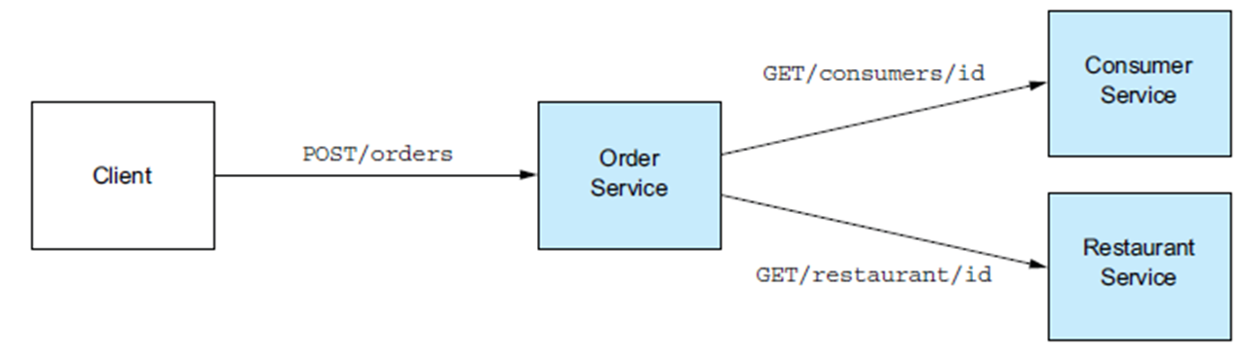
Synchronous APIs
A synchronous API is one where each request must wait for the previous one to complete before the next one can start.
Ex: REST, gRPC, GraphQL
Fig. Order service invokes other services using REST APIs
Notes:
The image you uploaded provides an explanation of Synchronous APIs along with an example of how they work.
Key Points:
Synchronous API:
In a synchronous API, each request must complete before the next one starts. This means the client making the request waits for a response before it can continue with any other actions.
Examples of synchronous APIs include REST, gRPC, and GraphQL.
Diagram Explanation:
The diagram below the explanation illustrates how an order service interacts with other services synchronously:
The client makes a POST request to the Order Service (e.g., to create an order).
The Order Service then calls other services, such as the Consumer Service (via GET /consumers/id) and the Restaurant Service (via GET /restaurant/id), to gather required data.
These calls are sequential. The Order Service must wait for responses from the Consumer and Restaurant Services before proceeding.
This setup shows the synchronous nature of API requests where tasks are processed one after the other, waiting for each response before moving on. This can result in slower performance if any of the services take time to respond, as the client remains blocked until all responses are received.

Slide 20
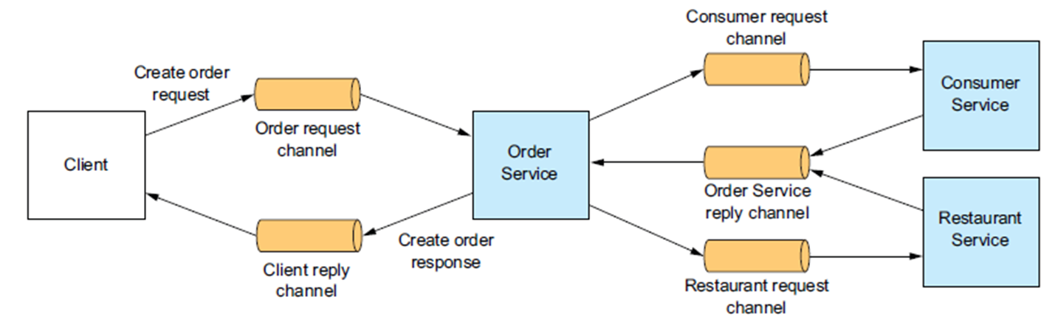
Asynchronous APIs
In contrast, an asynchronous API allows multiple operations to be initiated and potentially completed concurrently, without waiting for each operation to finish before starting the next one.
Ex: Message Brokers like RabbitMQ, Apache Kafka
Fig. Client and Order service invokes other services using message brokers
Notes:
The image you uploaded explains Asynchronous APIs and illustrates how they differ from synchronous APIs using message brokers like RabbitMQ or Apache Kafka.
Key Points:
Asynchronous API:
In an asynchronous API, multiple operations can be initiated and potentially completed concurrently, without waiting for each operation to finish before starting the next one. This allows for non-blocking operations and can significantly improve performance in distributed systems.
Examples of asynchronous APIs include systems that use Message Brokers such as RabbitMQ or Apache Kafka to manage the communication between different services.
Diagram Explanation:
The diagram below the text illustrates how an asynchronous API works:
The client sends a request to create an order, which is placed in an Order Request Channel.
The Order Service reads the order request from this channel and then invokes other services (e.g., Consumer Service and Restaurant Service) through their respective request channels.
While the Order Service processes the order, the client doesn’t wait for a direct response. Instead, the result is placed in a Client Reply Channel once the processing is complete, and the client can retrieve the response when ready.
In asynchronous communication:
The client doesn’t need to wait for the Order Service to complete its interactions with other services.
The services (Consumer and Restaurant) also process requests asynchronously, further enhancing efficiency by decoupling the communication between services.
By using message brokers, tasks can be handled independently and concurrently, improving scalability and responsiveness in distributed systems.

Slide 21
HTTP APIs

Slide 22
HTTP APIs
HTTP (Hypertext Transfer Protocol) APIs are a standard way for applications to communicate over the web.
Use HTTP Protocol
Define a set of rules and conventions for sending and receiving requests and responses between clients (such as web browsers or mobile apps) and servers.
Notes:
The image provides an overview of HTTP APIs:
Key Points:
HTTP APIs (Hypertext Transfer Protocol APIs):
HTTP APIs are a common and standard method for applications to communicate over the web. They enable interactions between clients (like web browsers or mobile apps) and servers using the HTTP protocol.
Use of HTTP Protocol:
The HTTP protocol defines how requests are sent from clients to servers and how servers respond. This protocol is the backbone of most modern web interactions.
Rules and Conventions:
HTTP APIs specify rules for formatting requests (such as GET, POST, PUT, DELETE methods) and receiving responses. These rules help in seamless communication between clients and servers, making them essential for web-based applications.
This slide emphasizes that HTTP APIs form a foundational structure for web applications, allowing for standardized communication across different platforms and systems.

Slide 23
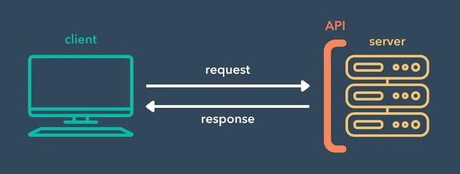
Components of HTTP API
API Endpoints
API Request
API Response
Notes:
The image outlines the Components of an HTTP API and illustrates the interaction between a client and a server using an API.
Key Components:
API Endpoints:
API endpoints are specific URLs that define where API requests are sent. Each endpoint corresponds to a specific resource or action (e.g., /orders for managing orders).
API Request:
The request is sent by the client to the server. It contains the HTTP method (such as GET, POST, PUT, or DELETE), headers, and possibly a payload (data). The request is aimed at interacting with a resource on the server.
API Response:
After processing the request, the server sends back an API response. This response typically contains status codes (e.g., 200 OK, 404 Not Found), headers, and often data in formats like JSON or XML.
Diagram Explanation:
The client (e.g., a web browser or app) sends a request to the server through an API.
The API acts as an interface between the client and the server, processing the request and sending back a response.
The diagram shows how communication happens in two steps:
Request: The client sends a request to the server.
Response: The server processes the request and returns the required response to the client.
This is the basic flow of how an HTTP API functions in a web-based application.

Slide 24
API Endpoints
The API endpoints are simple URLs that represent the collection of objects or a single object.
The resources are found usually on the server, the API endpoints are used to send the request to resources.
Each endpoint is a URL designed to perform a single function by accessing the required resources.
Endpoints act as the “doors” or “paths” through which a client application can send HTTP requests to the API server.
Notes:
The image provides an explanation of API Endpoints in the context of HTTP APIs.
Key Points:
API Endpoints are URLs:
API endpoints are simple URLs that represent a collection of objects or a single object. These are addresses where API resources can be accessed.
Resources on the Server:
The resources (such as data or services) are usually located on the server. API endpoints allow clients to send requests to access these resources.
Single Functionality per Endpoint:
Each API endpoint is typically designed to perform a specific function. For example, an endpoint could allow you to retrieve data about a user, create a new order, or delete a record.
Endpoints as Paths:
API endpoints serve as the "doors" or "paths" through which client applications (like web browsers or mobile apps) communicate with the API server. Through these paths, clients can send HTTP requests to retrieve or manipulate data.
In summary, API endpoints act as the entry points to an API server, facilitating communication between clients and servers by allowing the clients to perform specific operations on resources.

Slide 25
API Request
Client (Browser or Mobile) sends HTTP Request to a specific API endpoint
Purpose is to request data or perform a specific operation
Every API request begins with selecting appropriate HTTP method (or verb)
HTTP Methods / Verbs
GET: To retrieve data
POST: To submit data to the server
PUT: To update existing data
DELETE: To delete data
Ex: Facebook or Youtube
Notes:
The image explains the concept of an API Request and outlines the various HTTP methods (or verbs) used in API communication.
Key Points:
Client Sends HTTP Request:
The client (which can be a browser or a mobile application) sends an HTTP request to a specific API endpoint. This request is used to interact with the server to either retrieve, modify, or delete data.
Purpose of the API Request:
The request is typically used to either request data or perform a specific operation on the server. It’s the way the client communicates with the server to get things done.
HTTP Methods/Verbs:
Each API request begins with selecting the appropriate HTTP method, which specifies the type of operation the client wants to perform.
GET: To retrieve data from the server.
POST: To submit new data to the server (such as creating a new resource).
PUT: To update existing data on the server.
DELETE: To delete existing data on the server.
Examples:
Applications like Facebook or YouTube use API requests behind the scenes for actions such as fetching user data, posting new content, updating profiles, or deleting posts or comments.
This slide highlights the core functions of how clients make requests and the standard HTTP methods that are employed to interact with server resources.

Slide 26
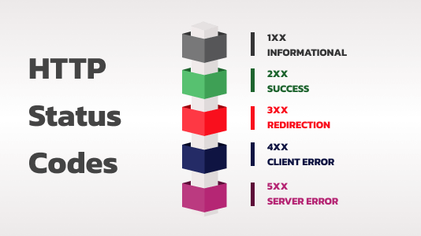
API Response
Refers to the data or information sent back by the API server after processing a request.
Formats: JSON / XML
200 OK: The request was successful, and the server is returning the requested data.
201 Created: The request has resulted in creating a new resource on the server.
204 No Content: The request was successful, but there is no data to return.
400 Bad request: The client’s request is malformed or contains errors.
401 Unauthorized: Authentication credentials are missing or invalid.
403 Forbidden: The client is not allowed to access the requested resource.
404 Not found: The requested resource does not exist.
500 Internal server error: An unexpected server error occurred.
Notes:
The image provides an overview of API Responses and the various HTTP Status Codes that indicate the outcome of an API request.
Key Points:
API Response:
The API response refers to the data or information sent back by the API server after processing a request from the client.
Common formats for API responses are JSON and XML.
HTTP Status Codes:
Status codes are used to indicate whether an API request was successful and to provide additional information about the result. The codes are typically grouped into five categories:
1XX Informational: The request was received and is being processed.
2XX Success: The request was successfully received, understood, and processed.
3XX Redirection: Further action needs to be taken by the client to complete the request.
4XX Client Error: The request contains bad syntax or cannot be fulfilled.
5XX Server Error: The server failed to fulfill a valid request.
Common Status Codes (as shown in the image):
200 OK: The request was successful, and the server is returning the requested data.
201 Created: The request resulted in creating a new resource on the server.
204 No Content: The request was successful, but no data is returned.
400 Bad Request: The client’s request is malformed or contains errors.
401 Unauthorized: Authentication credentials are missing or invalid.
403 Forbidden: The client is not allowed to access the requested resource.
404 Not Found: The requested resource does not exist.
500 Internal Server Error: An unexpected error occurred on the server.
This slide explains how API responses work and helps interpret the meaning of common HTTP status codes used in API interactions. These codes are vital for understanding the outcome of requests, troubleshooting errors, and ensuring smooth communication between clients and servers.

Slide 27
Try it!
Open your terminal
> curl -X GET "https://jsonplaceholder.typicode.com/posts"
HTTP Request - GET
HTTP Endpoint - https://jsonplaceholder.typicode.com/posts
HTTP Response – Posts in JSON format
Try with Fiddler application / Postman
Notes:
The image provides a hands-on example to help users try making an API request.
Instructions:
Open your terminal:
This exercise involves using the terminal to send an HTTP request using the curl command.
Curl Command:
The command to try:bash
Copy code
curl -X GET "https://jsonplaceholder.typicode.com/posts"
This command sends an HTTP GET request to the specified API endpoint (https://jsonplaceholder.typicode.com/posts).
HTTP Request:
GET method: The request is using the GET method to retrieve data from the API.
HTTP Endpoint:
The endpoint is https://jsonplaceholder.typicode.com/posts. This is a public API used for testing purposes, which returns a list of "posts" in JSON format.
HTTP Response:
After executing the command, the response will contain a list of posts, formatted in JSON.
Try with Tools:
You can also try this API request using applications like Fiddler or Postman. These tools are often used to test API requests and view responses in a more user-friendly interface.
This example demonstrates how to perform a basic HTTP GET request to an API endpoint using the curl command, making it easier to understand how API requests and responses work.

Slide 28
REST

Slide 29
REST
Architectural Style, Architecture of the Web. [Roy Fielding in 2000]
REST Architecture treats every content as a resource
Each resource identified by a URI (Uniform Resource Identifier)
Ex: Web pages, Image, Video, PDF, Dynamic business data etc.
Resource representation formats – JSON / XML
HTTP methods for CRUD (create, read, update, delete) operations on resources:
  GET: Retrieve representation of resource
  POST: Create a new resource
  PUT: Update/modify existing resource
  DELETE: Delete an existing resource
  * Suitable permissions are required for POST / PUT / DELETE operations
Notes:
The image provides an overview of REST (Representational State Transfer), an architectural style widely used for designing networked applications.
Key Points:
Architectural Style of the Web:
REST was defined by Roy Fielding in 2000 and serves as the foundational architecture of the modern web. RESTful services are based on the principles of this architecture.
REST Treats Every Content as a Resource:
In REST, any type of content (web pages, images, videos, PDF files, or business data) is treated as a resource that can be accessed or manipulated.
Each Resource is Identified by a URI:
Each resource is uniquely identified by a URI (Uniform Resource Identifier). This means that every resource on a RESTful server can be accessed via a specific URL or endpoint.
Resource Representation Formats:
Resources can be represented in various formats like JSON or XML. JSON is widely used due to its simplicity and ease of use.
HTTP Methods for CRUD Operations:
RESTful services use the following HTTP methods to perform CRUD (Create, Read, Update, Delete) operations:
GET: To retrieve a representation of a resource.
POST: To create a new resource.
PUT: To update or modify an existing resource.
DELETE: To delete an existing resource.
Suitable permissions are required for operations like POST, PUT, and DELETE to ensure security and proper access control.
Summary:
REST is an architectural style that allows systems to communicate and perform operations on resources using standard HTTP methods. Each resource is identified by a unique URI, and operations are performed using the appropriate HTTP methods. JSON and XML are commonly used formats for data exchange in RESTful APIs.
4o

Slide 30
REST
XML format
<user>
<id>1</id>
<name>Animesh</name>
<profession>Teacher</profession>
</user>
JSON format
{
"id“ : 1,
"name“ : “Animesh ",
"profession“ : "Teacher"
}
Notes:
The image provides an example of how a resource in a RESTful API can be represented in two different formats: XML and JSON.
XML Format:
xml
Copy code
<user> <id>1</id> <name>Animesh</name> <profession>Teacher</profession> </user>
In XML format, the data is structured with opening and closing tags. Each field (such as id, name, and profession) is wrapped in its corresponding tags.
XML uses a hierarchical structure with elements and attributes, making it a bit more verbose but very readable.
JSON Format:
json
Copy code
{ "id": 1, "name": "Animesh", "profession": "Teacher" }
In JSON format, the data is presented as key-value pairs inside curly braces {}. Each key (like "id", "name", and "profession") is followed by its corresponding value.
JSON is less verbose compared to XML and is widely used because it is lightweight, easy to read, and integrates well with JavaScript-based applications.
Comparison:
XML is often used for data representation in older systems and supports more complex structures with attributes, while JSON has become the de facto standard for web APIs due to its simplicity and smaller size, which makes it ideal for fast communication in web-based applications.
This slide emphasizes the flexibility of RESTful APIs to use different data formats, with JSON being more common in modern APIs.

Slide 31
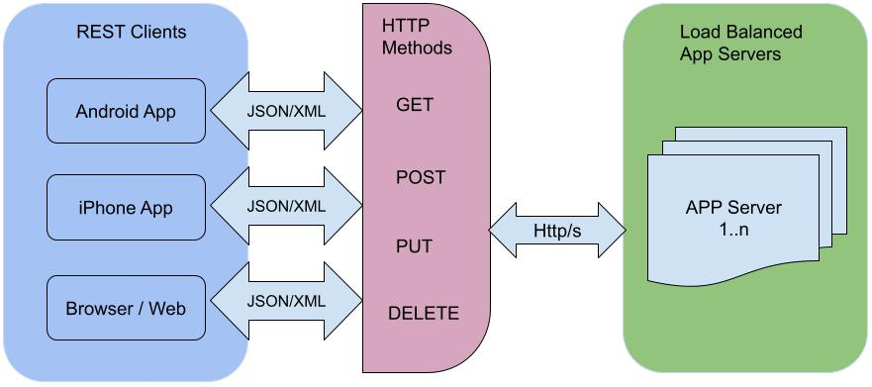
REST ARCHITECTURE
Notes:
The image illustrates the REST Architecture and how it facilitates communication between clients and servers using HTTP methods.
Key Components:
REST Clients:
REST clients can be various applications such as:
Android App
iPhone App
Browser/Web Application
These clients communicate with the server using RESTful APIs and exchange data in JSON or XML format.
HTTP Methods:
The core operations in RESTful APIs use standard HTTP methods, such as:
GET: To retrieve data from the server.
POST: To create a new resource on the server.
PUT: To update or modify an existing resource.
DELETE: To delete a resource on the server.
These methods are used to interact with resources defined on the server.
HTTP/S Protocol:
The communication between the clients and the server happens over HTTP or HTTPS (a secure version of HTTP). HTTPS ensures that the data transmitted is encrypted and secure.
Load Balanced App Servers:
The server side is shown as Load Balanced App Servers, which means the application is distributed across multiple servers (App Server 1 to App Server N).
Load balancing ensures that the client requests are evenly distributed across multiple servers, improving reliability and performance by preventing overloading of a single server.
Summary:
In REST architecture, clients (such as mobile apps or web browsers) communicate with servers via HTTP methods (GET, POST, PUT, DELETE). Data is typically exchanged in JSON or XML format, and communication happens over HTTP/S. On the server side, load-balanced app servers manage the requests to ensure scalability and availability.

Slide 32
REST - Examples
HTTP Method | URI | Operation
GET | https://www.bits.edu/institute/students | For fetching information for all students
GET | https://www.bits.edu/institute/students/123 | For fetching the student having ID 123
POST | https://www.bits.edu/institute/students | Submit the student information
PUT | https://www.bits.edu/institute/students/123 | Update the student information for student with ID 123
DELETE | https://www.bits.edu/institute/students/123 | Delete the student with ID 123
Sample curl commands
curl -X GET https://www.bits.edu/institute/students
curl -X GET "https://www.bits.edu/institute/students/123"
Guidelines for REST API design - https://www.freecodecamp.org/news/rest-api-best-practices-rest-endpoint-design-examples/
Notes:
The image provides examples of REST API operations using different HTTP methods with specific URIs.
REST Examples:
GET Request:
URI: https://www.bits.edu/institute/students
Operation: Fetch information for all students.
URI: https://www.bits.edu/institute/students/123
Operation: Fetch information for the student with ID 123.
POST Request:
URI: https://www.bits.edu/institute/students
Operation: Submit student information (used to create a new student record).
PUT Request:
URI: https://www.bits.edu/institute/students/123
Operation: Update student information for the student with ID 123.
DELETE Request:
URI: https://www.bits.edu/institute/students/123
Operation: Delete the student with ID 123.
Sample curl Commands:
To fetch all students:bash
Copy code
curl -X GET https://www.bits.edu/institute/students
To fetch the student with ID 123:bash
Copy code
curl -X GET "https://www.bits.edu/institute/students/123"
These examples demonstrate how different HTTP methods (GET, POST, PUT, DELETE) interact with a RESTful API to perform CRUD operations (Create, Read, Update, Delete) on resources like student information. The URI defines the resource, and the method specifies the operation to be performed on that resource.
The examples follow best practices for REST API design, including clear URIs that indicate resources (like students) and actions (based on HTTP methods).

Slide 33
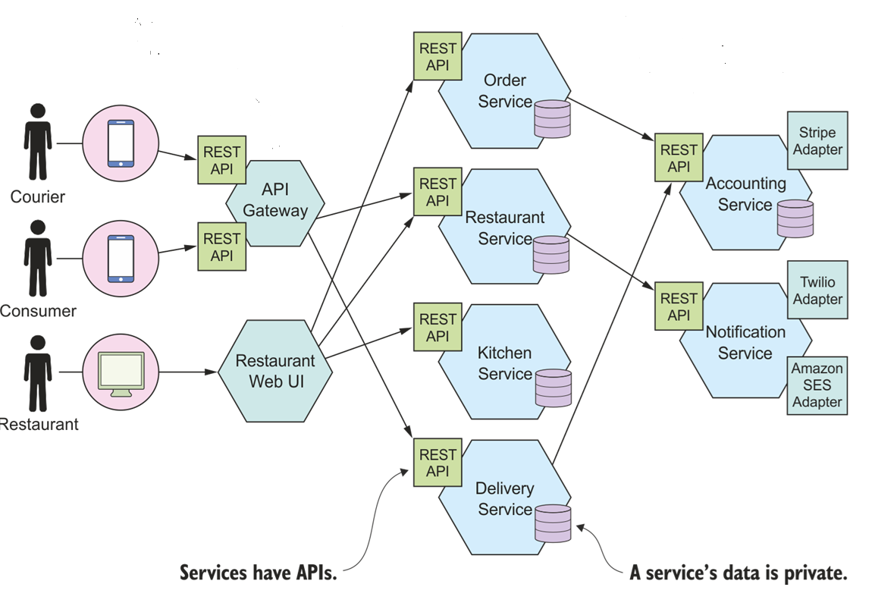
RESTful API based Application
[Food Delivery App]
Notes:
The image illustrates the architecture of a RESTful API-based Food Delivery Application. This architecture showcases how different services interact using REST APIs, enabling smooth communication across various components of the application.
Key Components:
Users/Clients:
Courier, Consumer, and Restaurant:
These are the different types of users interacting with the system. They access the services using mobile apps or web interfaces.
Each user interacts with the application via REST APIs, which allow them to make requests (such as placing orders, updating delivery status, etc.).
API Gateway:
The API Gateway serves as the entry point for all API requests. It directs the requests to the appropriate backend services. This central gateway improves security, scalability, and manageability.
Services:
Each backend component in the application is represented as a service, with its own REST API to interact with:
Order Service: Handles order creation, updates, and tracking.
Restaurant Service: Manages restaurant information, menus, and availability.
Kitchen Service: Tracks the preparation status of food orders.
Delivery Service: Manages delivery assignments and tracks courier locations.
Accounting Service: Handles billing and payments, often integrated with external services (like Stripe).
Notification Service: Sends notifications (SMS, email) using external services (e.g., Twilio for SMS, Amazon SES for email).
External Services:
The architecture integrates external services via adapters:
Stripe Adapter: For managing payments and transactions.
Twilio Adapter: For sending SMS notifications.
Amazon SES Adapter: For sending email notifications.
REST APIs in Action:
Courier: Uses the REST API to receive delivery assignments and update the status of deliveries.
Consumer: Uses the REST API to browse restaurants, place orders, and receive notifications about order status.
Restaurant: Uses the REST API to manage orders from the consumer, update menu items, and track kitchen operations.
Key Design Principles:
Each service has its own API: This means the services are loosely coupled, which improves flexibility and scalability.
Data privacy: Each service manages its own data privately. This ensures that services can be modified or scaled independently.
Summary:
The architecture shows how a food delivery app utilizes multiple microservices, each exposed via REST APIs. By decoupling services such as Order, Restaurant, Kitchen, Delivery, Accounting, and Notification, the system achieves high scalability, modularity, and ease of maintenance. This architecture supports various clients (couriers, consumers, restaurants) with their distinct needs, while also integrating external services for payments and notifications.

Slide 34
REST – Benefits and Drawbacks
Benefits
Mature and ubiquitous – de facto standard for APIs
Testing a REST API is simple
Supports synchronous request-response communication
No intermediate broker
Supported by most programming languages / frameworks
Drawbacks
Reduced availability
Fetching multiple resources [fetching a user’s profile, their posts, and comments might require three separate API calls.]
Notes:
The image outlines the Benefits and Drawbacks of using RESTful APIs.
Benefits:
Mature and Ubiquitous:
REST is widely adopted and has become the de facto standard for APIs across industries. It is mature and well understood, making it a reliable choice for developers.
Simple to Test:
Testing a REST API is straightforward. Tools like Postman, Curl, or even a web browser can be used to easily send HTTP requests and view the responses.
Synchronous Communication:
REST supports synchronous request-response communication. This means that the client sends a request and waits for a response, ensuring that tasks are completed sequentially.
No Intermediate Broker:
REST APIs do not require an intermediate message broker or queue between the client and server, simplifying the architecture.
Wide Support:
REST is supported by almost all programming languages and frameworks, making it accessible and versatile for developers working in different environments.
Drawbacks:
Reduced Availability:
The synchronous nature of REST can lead to reduced availability if one service is down or slow. The client has to wait for a response, which can block further actions.
Multiple API Calls for Multiple Resources:
Fetching multiple resources often requires separate API calls. For instance, if a user’s profile, posts, and comments need to be retrieved, it may require three separate requests, potentially leading to inefficiencies in terms of performance and increased load on the network.
Summary:
While REST is a simple and widely supported solution for building APIs, its synchronous nature and need for multiple calls to fetch related resources can lead to some drawbacks, particularly when dealing with large-scale or high-availability systems. However, its maturity, simplicity in testing, and extensive framework support make it a highly popular choice for many applications.

Slide 35
Why RESTful APIs are important for this course?
Most AI services from AWS, Azure or GCP support RESTFul APIs
Ex: Amazon Bedrock is a tool to build generative AI apps with foundation models
Sample APIs from Amazon Bedrock
Model Inference
Endpoint: https://bedrock.us-west-2.amazonaws.com/models/{model-id}/invoke
[Pass request with access tokens, and response in JSON]
List models
Endpoint: https://bedrock.us-west-2.amazonaws.com/models
[Pass request with access tokens, and response in JSON]
* Same is true for HuggingFace, LangChain, Prefect which support RESTful APIs
Notes:
The image explains Why RESTful APIs are important for the course, particularly in the context of AI services from major cloud providers like AWS, Azure, and GCP, which all support RESTful APIs.
Key Points:
AI Services and RESTful APIs:
Most AI services offered by cloud providers like AWS, Azure, and Google Cloud Platform (GCP) provide access through RESTful APIs.
Example: Amazon Bedrock is a tool that allows developers to build generative AI applications using foundation models. These services use REST APIs for various interactions, such as model inference and listing available models.
Sample APIs from Amazon Bedrock:
Model Inference:
Endpoint:bash
Copy code
https://bedrock.us-west-2.amazonaws.com/models/{model-id}/invoke
This API is used to invoke a foundation model for inference. The request needs to include access tokens, and the response is returned in JSON format.
List Models:
Endpoint:bash
Copy code
https://bedrock.us-west-2.amazonaws.com/models
This API lists the available models. As with the previous example, access tokens are required, and responses are in JSON format.
Other Platforms Supporting RESTful APIs:
The same approach applies to other popular AI tools such as HuggingFace, LangChain, and Prefect, which also offer APIs that follow REST principles.
Summary:
RESTful APIs are vital for accessing AI services in cloud platforms. They allow users to interact with advanced AI models (such as those provided by Amazon Bedrock) easily by sending HTTP requests. Understanding and using REST APIs is crucial for integrating these services into applications, making this knowledge highly relevant to any course on AI, cloud computing, or software development.

Slide 36
Open API Specification
https://www.openapis.org/
Notes:
The image introduces the Open API Specification (OAS), along with a link to its official website: https://www.openapis.org/.
Key Points:
Open API Specification (OAS) is a standard for defining and documenting RESTful APIs.
It allows developers to describe the entire API, including endpoints, request/response formats, authentication, and more, in a machine-readable format (usually in JSON or YAML).
OAS is widely used to ensure that APIs are well-documented, which helps both developers and tools to understand how to interact with the API.
This standard is particularly useful for generating client SDKs, API testing tools, and documentation automatically.
By using the Open API Specification, developers can streamline API development, ensure consistency, and make it easier for consumers of the API to integrate and use the service.
For more information, you can visit the official site: https://www.openapis.org/.

Slide 37
What is OpenAPI
The OpenAPI Specifications [previously Swagger specification] provides a formal standard for describing HTTP APIs, mainly RESTful APIs.
This allows people to understand how an API works, how a sequence of APIs work together, generate client code, create tests, apply design standards etc.
Notes:
The image explains What is OpenAPI and provides an overview of its purpose.
Key Points:
OpenAPI Specification:
OpenAPI (previously known as Swagger) is a formal standard for describing HTTP APIs, with a particular focus on RESTful APIs. It defines a clear structure for how an API should work and how requests and responses are handled.
Understanding API Functionality:
OpenAPI allows developers and users to understand how an API functions, how different API endpoints work together, and the flow of requests and responses.
It also defines how to generate client code, create tests, and apply design standards, ensuring consistency and reliability across different systems.
Summary:
The OpenAPI Specification is crucial for creating well-documented, standardized APIs. It helps developers understand the API structure and facilitates tools like automatic client generation and testing. Its wide adoption makes it an essential tool for modern API design and implementation.

Slide 38
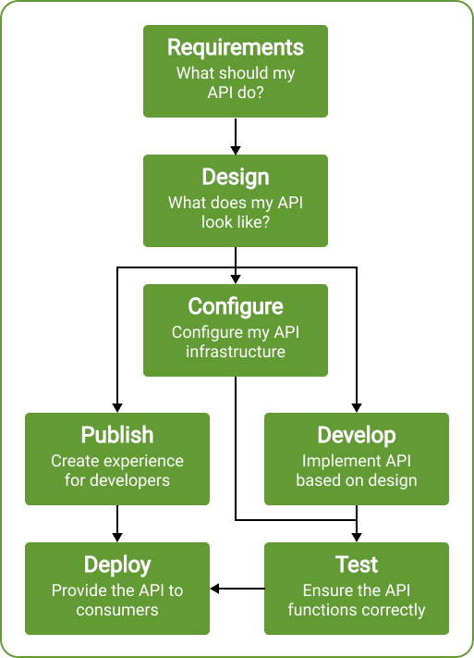
What is OpenAPI
Notes:
The image presents a flowchart that outlines the lifecycle of an API using OpenAPI. Here's a breakdown of each stage in the process:
OpenAPI Lifecycle Stages:
Requirements:
What should my API do?
This is the first step where the functionality of the API is defined. It involves understanding the purpose of the API and what problem it will solve for users.
Design:
What does my API look like?
Once the requirements are gathered, the next step is to design the API. This includes defining endpoints, request/response formats, authentication, and more.
Configure:
Configure my API infrastructure
This involves setting up the infrastructure where the API will run, ensuring the necessary environments, security protocols, and configurations are in place.
Publish:
Create experience for developers
The API is documented and made accessible for developers to understand how to interact with it. OpenAPI helps generate documentation automatically, providing a clear overview of how the API works.
Develop:
Implement API based on design
This is the coding phase where the API is built according to the design and specifications defined earlier.
Test:
Ensure the API functions correctly
Before deployment, the API is tested to ensure it meets the functional requirements, works as expected, and handles errors appropriately.
Deploy:
Provide the API to consumers
Once the API is tested, it is deployed and made available for use by clients or other systems.
Summary:
This flowchart illustrates the typical stages involved in developing an API with OpenAPI. The process starts with gathering requirements, followed by design and configuration, then moves on to development, testing, and deployment. Throughout the lifecycle, OpenAPI helps ensure that the API is well-structured, documented, and ready for consumer use.

Slide 39
Bookstore Scenario
Let's go through the entire process with a practical example of building a RESTful API for an online bookstore using Python and FastAPI.
Notes:
The image presents a Bookstore Scenario as a practical example of building a RESTful API for an online bookstore using Python and FastAPI. It walks through the steps in the API development process.
Key Points:
Requirements:
Define what the API should do. For the bookstore, this could include operations like listing available books, searching by genre, adding new books, updating book information, and handling customer orders.
Design:
Plan what the API will look like. This involves defining endpoints such as:
/books for listing all books.
/books/{id} for getting details of a specific book.
/orders for placing an order.
You would also decide the data formats (JSON), request/response structures, and authentication.
Configure:
Configure the infrastructure for the API. This includes setting up the FastAPI framework, databases, and any external services needed to support the online bookstore, such as payment gateways or delivery tracking.
Develop:
Implement the API according to the design. Write the actual Python code using FastAPI to build the functionality, such as fetching data from a database, validating inputs, and managing sessions.
Test:
Ensure the API functions as expected. You would create and run tests to check if all endpoints are working properly, whether the bookstore API can handle different scenarios (e.g., invalid requests, large datasets), and ensure it responds with the correct status codes.
Publish:
Create an experience for developers by generating API documentation. FastAPI can automatically generate documentation based on the OpenAPI specification, making it easier for other developers to integrate with your API.
Deploy:
Make the API available to consumers (e.g., web or mobile apps that need to access the bookstore's data). This step involves deploying the API on a server, configuring scaling and security, and ensuring it's accessible to clients.
Summary:
This scenario guides you through building a practical RESTful API for an online bookstore, covering all the necessary stages from requirements to deployment, using Python and FastAPI. The process emphasizes how to plan, design, implement, and test APIs to ensure a smooth user experience for consumers and developers alike.
4o

Slide 40
1. Requirements
The API should allow users to manage books [CRUD operations]
  add a new book
  retrieve book details
  update book information
  delete books
Notes:
The image outlines the Requirements for the Bookstore API.
Key Requirements:
The API should allow users to manage books by performing basic CRUD operations (Create, Read, Update, Delete). Specifically, the API should support the following:
Add a New Book (Create):
The API should allow users to add new books to the system.
Retrieve Book Details (Read):
Users should be able to fetch the details of a book, such as title, author, and description, by querying the API.
Update Book Information (Update):
The API should enable users to update the information of an existing book, such as changing the price, updating the inventory, or modifying the book description.
Delete Books (Delete):
Users should be able to delete books from the system when they are no longer available or relevant.
Summary:
These CRUD operations form the backbone of the Bookstore API, allowing users to manage the books in the system effectively. By supporting these operations, the API will provide a complete solution for handling book data in an online bookstore application.

Slide 41
2. Design
Identify the API Endpoints
GET /books
POST /books
GET /books/{id}
PUT /books/{id}
DELETE /books/{id}
Sample Data Model for “book”
{
"id": integer,
"title": "string",
"author": "string",
"isbn": "string",
"publishedDate": "string",
"price": integer
}
Notes:
The image outlines the Design phase for the Bookstore API by identifying the key API endpoints and a sample data model for a book.
API Endpoints:
GET /books:
Retrieves a list of all books in the system.
POST /books:
Adds a new book to the system. The request body will contain the necessary book details, such as title, author, and price.
GET /books/{id}:
Retrieves the details of a specific book by its unique ID.
PUT /books/{id}:
Updates the information of a specific book by its unique ID. The request body will include updated book data.
DELETE /books/{id}:
Deletes a specific book by its unique ID from the system.
Sample Data Model for a "Book":
json
Copy code
{ "id": integer, "title": "string", "author": "string", "isbn": "string", "publishedDate": "string", "price": integer }
This data model represents the structure of a book object. It includes:
id: A unique identifier for the book (integer).
title: The title of the book (string).
author: The author of the book (string).
isbn: The ISBN number of the book (string).
publishedDate: The date when the book was published (string).
price: The price of the book (integer).
Summary:
This phase of the design specifies the core endpoints required to perform CRUD operations on the books in the bookstore. It also provides a clear structure for the book data model, ensuring that all interactions with the API will follow a consistent format for sending and receiving book-related information.
4o

Slide 42
3. Configure and 4. Publish
Configure / Identify:
FastAPI framework in Python for development
Uvicorn as the Web Server
JSON for storing the Book details
Publish
Documentation is auto-generated by FastAPI and available at /docs
URL - Localhost:8000/docs
Notes:
The image outlines the Configure and Publish stages of developing the Bookstore API.
3. Configure / Identify:
FastAPI framework in Python:
FastAPI is used as the primary framework for developing the API. It is chosen for its speed, ease of use, and automatic generation of documentation.
Uvicorn as the Web Server:
Uvicorn is employed as the server to run the FastAPI application. It is an asynchronous server that is highly efficient for handling requests.
JSON for storing Book details:
The API will use JSON (JavaScript Object Notation) as the data format for handling and storing book details, making it simple to exchange data between the server and clients.
4. Publish:
Auto-generated Documentation:
FastAPI automatically generates interactive API documentation (using OpenAPI and Swagger) based on the defined routes and models.
URL for Documentation:
The API documentation is available at localhost:8000/docs after deploying the server. This URL provides an interactive interface for developers to test the API endpoints.
Summary:
The Configure phase involves setting up the FastAPI framework, Uvicorn server, and JSON for data handling. In the Publish phase, FastAPI's auto-generated documentation provides a convenient interface for developers to explore and test the API. The documentation is accessible at localhost:8000/docs after deployment.

Slide 43
5. Develop 6. Test 7. Deploy
Develop
Implement the API using FastAPI.
Implement all HTTP methods for GET, POST, PUT and DELETE
Test
Use “pytest” or “unittest” frameworks for testing
Deploy
Various platforms such as Heroku, AWS, Google Cloud can be used
Notes:
The image details the final stages of the Bookstore API development process: Develop, Test, and Deploy.
5. Develop:
Implement the API using FastAPI:
During the development phase, you build the API using the FastAPI framework in Python. This involves setting up the different routes and functionalities defined in the design stage.
Implement all HTTP methods for GET, POST, PUT, and DELETE:
For the Bookstore API, you need to ensure that all CRUD operations are properly implemented using these HTTP methods:
GET: Retrieve data (books).
POST: Create new entries (add books).
PUT: Update existing data (modify book details).
DELETE: Remove data (delete books).
6. Test:
Use pytest or unittest frameworks for testing:
It's essential to test the API to ensure it works as expected. Popular testing frameworks like pytest or unittest can be used to automate these tests and ensure that each API endpoint behaves correctly under various scenarios, including edge cases and error handling.
7. Deploy:
Deployment options:
Once the API has been developed and tested, it's ready to be deployed. There are multiple platforms where you can deploy the API, including:
Heroku
AWS (Amazon Web Services)
Google Cloud
These platforms offer hosting services, allowing users to access the API in a production environment.
Summary:
The final steps involve developing the Bookstore API by implementing all HTTP methods using FastAPI, testing the API with tools like pytest or unittest, and deploying it to platforms such as Heroku, AWS, or Google Cloud for production use. This ensures that the API is fully functional and accessible to users.

Slide 44
Demo
Demo of the Bookstore application using RESTful APIs
Notes:
The image appears to contain the title "Demo of the Bookstore application using RESTful APIs." This suggests a demonstration of how the Bookstore API, built using RESTful APIs, would function.
In such a demo, you might typically showcase the following:
Overview of the API:
Introduce the purpose of the API (managing books in an online bookstore) and the CRUD operations it supports (create, read, update, delete).
Demonstration of Endpoints:
Show how to interact with the API using tools like Postman or curl commands.
Examples of interacting with each of the API endpoints:
GET /books: Fetching a list of all books.
POST /books: Adding a new book to the database.
GET /books/{id}: Retrieving details of a specific book by its ID.
PUT /books/{id}: Updating a book's information.
DELETE /books/{id}: Deleting a book from the system.
Responses and Formats:
Demonstrate how the API responds with JSON data for each request.
Show different response status codes (200 OK, 404 Not Found, 201 Created) based on the actions taken.
Testing and Error Handling:
Include tests for valid and invalid inputs, showing how the API handles different scenarios, such as missing data or incorrect IDs.
This would provide a comprehensive walkthrough of how the Bookstore application functions through RESTful APIs.

Slide 45
GraphQL
Notes:
"GraphQL," which indicates a focus on GraphQL, a query language for APIs.
Key Points About GraphQL:
GraphQL is an alternative to REST for building APIs. It allows clients to specify the exact data they need, which makes data fetching more efficient.
Single Endpoint: Unlike REST, where there are multiple endpoints for different resources, GraphQL typically operates on a single endpoint (/graphql).
Flexible Queries: Clients can request only the fields they need from a resource, avoiding over-fetching or under-fetching of data.
Schema-Based: GraphQL APIs have a strong type system, with a schema that defines the types and relationships between data.
Example Scenario for a Bookstore Application:
Instead of having separate endpoints like /books or /books/{id} as in REST, with GraphQL, a single query might be used to fetch books along with specific details like the title and author.
Example query:
graphql
Copy code
query { books { title author } }
This query would return a list of books, including only the title and author fields, making it more efficient than fetching all fields as in REST.
GraphQL is widely used when flexibility in data querying is needed, and it is highly suitable for applications that handle complex data with multiple relationships.

Slide 46
REST
Scenario - Fetch user profile, user posts and comments on the posts from a Social Media Application
REST Drawback - Fetching multiple resources requires multiple HTTP requests
REST
1. Fetch user profile - GET /users/{userId}
2. Fetch user posts - GET /users/{userId}/posts
3. Fetch comments on posts – GET /posts/{postId}/comments
Notes:
The image illustrates a common REST drawback when fetching multiple resources from a social media application.
Scenario:
The goal is to fetch a user profile, the user's posts, and the comments on those posts from a social media application.
REST Drawback:
Fetching multiple resources requires multiple HTTP requests.
In REST, each resource often has a dedicated endpoint. Therefore, retrieving related resources, such as a user profile, their posts, and the comments on those posts, requires multiple requests to the server.
REST Requests:
Fetch user profile:
GET /users/{userId}
This request fetches the profile information for the user with a specific ID.
Fetch user posts:
GET /users/{userId}/posts
This request retrieves all posts made by the user with the specified ID.
Fetch comments on posts:
GET /posts/{postId}/comments
This request retrieves comments for a particular post, identified by its post ID.
Summary:
While RESTful APIs are easy to implement, they can be inefficient in scenarios where multiple resources need to be fetched. Each resource requires a separate HTTP request, leading to multiple round trips to the server, increasing latency, and reducing performance, especially in high-latency environments. This is one of the challenges addressed by alternative approaches like GraphQL, which allows fetching related data in a single request.

Slide 47
GraphQL
To overcome drawbacks of REST
Facebook in 2015 came up with new API Syntax – GraphQL
It can even be deployed within an integrated development environment (IDE) known as GraphiQL.
As an alternative to REST, GraphQL is a versatile query language, that lets developers construct requests that pull data from multiple data sources in a single API call. [Connect to multiple endpoints or databases]
Single request and all-inclusive reply
Uses ‘query’ operation to fetch data
Uses ‘mutation’ operations to insert, update, or delete data.
https://graphql.org/
Notes:
The image explains GraphQL as a solution to overcome the drawbacks of REST.
Key Points about GraphQL:
Overcoming REST's Drawbacks:
GraphQL was developed by Facebook in 2015 to address issues like the need for multiple HTTP requests to fetch related data in REST APIs.
API Syntax:
GraphQL introduces a new API syntax and query language that allows clients to request exactly the data they need, even across multiple resources, in a single API call.
Integrated Development Environment (IDE):
GraphQL can be deployed within development environments like GraphiQL, an interactive tool for testing and querying GraphQL APIs.
Alternative to REST:
GraphQL is highly versatile and allows developers to construct requests that pull data from multiple data sources in a single query.
It connects to multiple endpoints or databases and returns all the necessary data in one comprehensive response.
Single Request and Comprehensive Reply:
With GraphQL, developers send a single request and receive all relevant data in one response, eliminating the need for multiple requests to various endpoints.
Operations in GraphQL:
Query: Used to fetch data.
Mutation: Used to insert, update, or delete data.
Advantages:
GraphQL significantly reduces over-fetching or under-fetching of data by letting clients specify exactly what they need.
It allows complex, nested data retrieval in one API call, improving efficiency and performance.
Learn More:
The official GraphQL website: https://graphql.org/
Summary:
GraphQL offers a more flexible and efficient alternative to REST by allowing clients to query multiple resources in a single request. It provides a structured way to fetch, insert, update, or delete data while reducing the number of API calls needed.

Slide 48
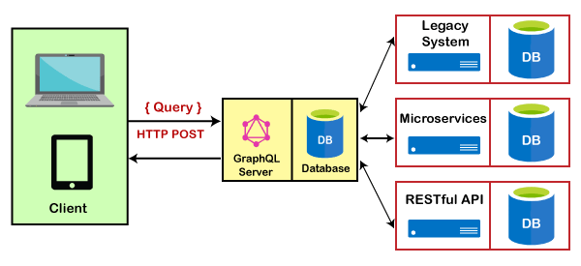
GraphQL
Schema definition – Define a schema that specifies types of data to be queried and their relationships. Defined using GraphQL Schema Definition Language (SDL).
Clients send Query (read) or Mutation (update) requests to GraphQL server
Server implements "resolvers“ which are functions to handle each field in query or mutation
Validation, execution and response formation – GraphQL server validates client request against the schema, executes on the endpoint /graphql and replies in JSON format
Clients can only fetch data needed, based on the fields
Notes:
The image explains how GraphQL works and highlights the flow between the client, GraphQL server, and various data sources.
How GraphQL Works:
Schema Definition:
GraphQL APIs rely on a schema that defines the types of data that can be queried and the relationships between them. This schema is created using the GraphQL Schema Definition Language (SDL).
The schema allows the GraphQL server to know exactly what data is available and how it is structured.
Client Requests (Query or Mutation):
Clients (like web or mobile apps) send requests to the GraphQL server:
Query: Used to read or fetch data.
Mutation: Used to update or modify data.
These requests are typically sent via HTTP POST to a single GraphQL endpoint (e.g., /graphql).
Resolvers:
On the server side, resolvers are functions that handle each field in the query or mutation request. They interact with the underlying data sources (databases, microservices, or even legacy systems) to fetch or update the required data.
Validation, Execution, and Response:
The GraphQL server validates the request against the defined schema, ensuring the query adheres to the API structure.
Once validated, the query is executed, and the server gathers the necessary data, forming a response in JSON format.
The response includes only the data fields requested by the client, optimizing the efficiency of data retrieval.
Selective Data Fetching:
One of GraphQL's strengths is that clients can fetch only the data they need by specifying the fields in the query. This prevents over-fetching or under-fetching of data, which is a common issue with REST.
Diagram Explanation:
Client: A user device (like a laptop or mobile) sends queries or mutations.
GraphQL Server: Acts as the intermediary between the client and the data sources, ensuring the query is handled correctly.
Data Sources: GraphQL can pull data from various sources such as:
Legacy systems (older databases)
Microservices (distributed services)
REST APIs (other existing APIs)
Summary:
The key components of GraphQL include the schema, client queries/mutations, resolvers, and the response. Clients request only the specific data they need, making GraphQL an efficient alternative to REST, especially for complex data-fetching scenarios. The GraphQL server acts as a middleware that connects to multiple backends, ensuring data is fetched and returned according to the client's query.

Slide 49
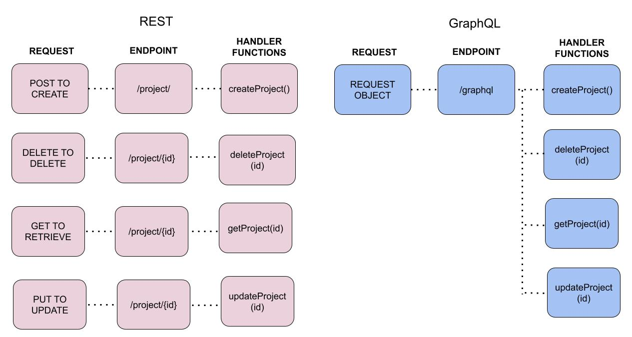
GraphQL
Notes:
This image provides a comparison between REST and GraphQL by illustrating how requests are handled in both API models.
REST:
In REST, each operation has its own endpoint.
To create a resource, a POST request is made to /project/.
To delete a resource, a DELETE request is made to /project/{id}.
To retrieve a resource, a GET request is made to /project/{id}.
To update a resource, a PUT request is made to /project/{id}.
Each request is handled by a specific handler function (e.g., createProject(), deleteProject(id), etc.).
Each operation requires a different HTTP method and endpoint.
GraphQL:
In GraphQL, all operations are handled through a single endpoint: /graphql.
The client sends a request object to the GraphQL endpoint, which contains the details of what data to fetch, update, or delete.
The same handler functions (e.g., createProject(), deleteProject(id), etc.) are used, but they are executed based on the request made through GraphQL.
Instead of multiple endpoints, GraphQL uses a single request structure where clients can define the specific operations they want, allowing more flexibility in fetching and modifying data.
Key Differences:
REST uses multiple endpoints and HTTP methods for each operation, while GraphQL uses one endpoint with a flexible query structure.
GraphQL allows clients to request exactly what they need, while REST typically requires multiple endpoints for different operations, which can lead to over-fetching or under-fetching data.

Slide 50
GraphQL
Data in JSON format
{
"data": {
"books": [
{
"title": "To Kill a Mockingbird",
"author": "Harper Lee",
"publishedDate": "July 11, 1960"
},
{
"title": "1984",
"author": "George Orwell",
"publishedDate": "June 8, 1949"
},
{
"title": "The Great Gatsby",
"author": "F. Scott Fitzgerald",
"publishedDate": "April 10, 1925"
}
]
}
}
GraphQL Query
query {
books {
title
author
publishedDate
}
}
Sample Data Model for “book”
{
"id": integer,
"title": "string",
"author": "string",
"isbn": "string",
"publishedDate": "string",
"price": integer
}
Notes:
This image showcases how a GraphQL query works and the resulting JSON data that is returned in response.
GraphQL Query:
The query is asking for a list of books and specifically requesting the following fields:
title
author
publishedDate
graphql
Copy code
query { books { title author publishedDate } }
JSON Data Response:
The server returns the data in JSON format that matches the structure of the query.
The response contains an array of books, each with the fields that were requested (title, author, publishedDate).
json
Copy code
{ "data": { "books": [ { "title": "To Kill a Mockingbird", "author": "Harper Lee", "publishedDate": "July 11, 1960" }, { "title": "1984", "author": "George Orwell", "publishedDate": "June 8, 1949" }, { "title": "The Great Gatsby", "author": "F. Scott Fitzgerald", "publishedDate": "April 10, 1925" } ] } }
Data Model for "Book":
The sample data model for the book structure includes fields like:
id: Integer
title: String
author: String
isbn: String
publishedDate: String
price: Integer
This example highlights how GraphQL allows clients to request specific data, optimizing data retrieval by only fetching the required fields, which is a key advantage over REST where entire resources are fetched even if only a subset is needed.

Slide 51
REST vs GraphQL - Example
Scenario - Fetch user profile, user posts and comments on the posts from a Social Media Application
GraphQL
query {
user(id: "123") {
id
name
posts {
id
title
comments {
id
content
}
}
}
}
REST
1. Fetch user profile - GET /users/{userId}
2. Fetch user posts - GET /users/{userId}/posts
3. Fetch comments on posts –
GET /posts/{postId}/comments
Notes:
This image provides an excellent comparison between REST and GraphQL using a scenario where a social media application needs to fetch a user profile, user posts, and comments on those posts.
REST Approach:
Fetch user profile:
Method: GET
Endpoint: /users/{userId}
Fetch user posts:
Method: GET
Endpoint: /users/{userId}/posts
Fetch comments on posts:
Method: GET
Endpoint: /posts/{postId}/comments
Key Issue with REST:
Multiple endpoints are needed to fetch related data, leading to multiple HTTP requests. This increases the complexity and load on the network and server.
GraphQL Approach:
In contrast, with GraphQL, a single query can fetch all required information, including the user profile, their posts, and the comments on those posts, in one request.
graphql
Copy code
query { user(id: "123") { id name posts { id title comments { id content } } } }
Advantages of GraphQL:
Single Request: All the required data can be retrieved with a single API call.
Specific Data: The client only retrieves the fields that it needs, reducing the payload and improving performance.
In summary, while REST requires multiple requests to gather related data, GraphQL simplifies this by allowing all related data to be fetched in a single, flexible query.

Slide 52
Demo - GraphQL
Show a GraphQL Query Demo using Strawberry GraphQL Library in Python using the code first approach
Notes:
This slide presents a GraphQL Demo that showcases the implementation of a GraphQL query using the Strawberry GraphQL library in Python, focusing on a code-first approach.
Strawberry GraphQL is a Python library that allows you to create GraphQL APIs using Python’s type hints, offering a clean and simple way to define your schema directly in the code.
In this demo, the code-first approach means that:
The GraphQL schema is generated directly from Python classes and functions, allowing developers to work in a Pythonic way while defining queries, mutations, and types.
The process would typically involve:
Installing the Strawberry library.
Defining your GraphQL types using Python classes and decorators.
Creating query resolvers that map to the operations the API will support.
Starting a GraphQL server, which can be done using FastAPI or Django as a backend framework for Strawberry GraphQL.

Slide 53
gRPC
Notes:
It looks like you are presenting a topic related to gRPC. gRPC (Google Remote Procedure Call) is a high-performance, open-source universal RPC framework initially developed by Google. It enables the development of APIs using protocol buffers (protobuf) as its Interface Definition Language (IDL). gRPC is designed for low-latency, high-throughput communication and can be used for building scalable, distributed systems.
Key points about gRPC include:
Binary Protocol: gRPC uses a binary protocol (Protocol Buffers) which is more efficient in size and speed compared to text-based protocols like JSON used in REST.
Supports multiple programming languages: gRPC has libraries for many programming languages, including Python, Java, Go, C++, etc.
Supports streaming: It allows for both client-side and server-side streaming, making it powerful for real-time applications.
HTTP/2 based: gRPC uses HTTP/2, which enables multiplexing of requests, improved speed, and handling of more connections simultaneously.

Slide 54
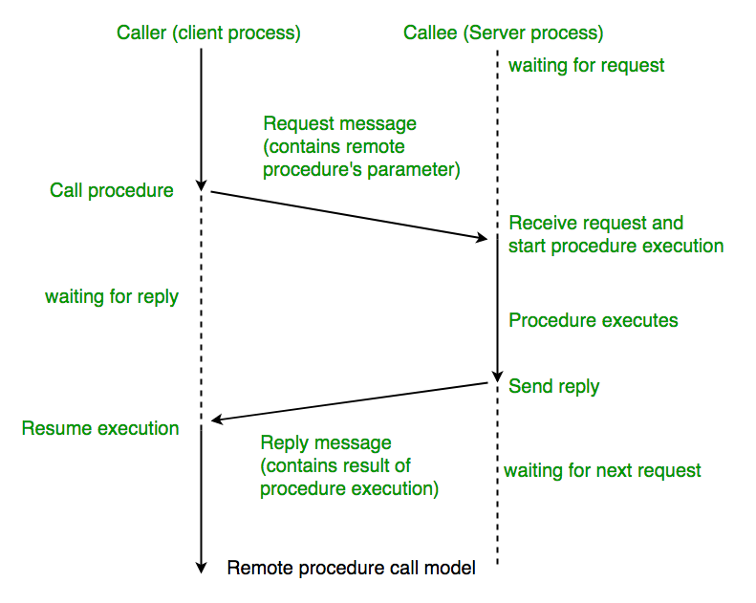
RPC
Remote Procedure Call (RPC) is a communication between client and remote server
Used for distributed, client-server applications
Notes:
This slide presents the concept of Remote Procedure Call (RPC), a protocol that allows a program to request a service from a program located on another computer in a network. The slide outlines the sequence of communication between the caller (client) and the callee (server) processes.
Key steps of the RPC model:
Caller (Client Process) Calls Procedure: The client initiates the process by making a request to the server.
Request Message Sent: The client sends a request message, which contains the parameters of the remote procedure, to the server.
Callee (Server Process) Receives Request: The server, upon receiving the request, begins executing the requested procedure.
Server Executes Procedure: The procedure is executed on the server side, processing the data.
Server Sends Reply: Once the procedure execution is complete, the server sends back a response with the result to the client.
Client Receives Reply: The client receives the reply message with the result and resumes execution.
This communication happens in a synchronous manner—meaning the client waits for the server's response before continuing its execution. RPC is used in distributed systems to abstract network communication, making it

Slide 55
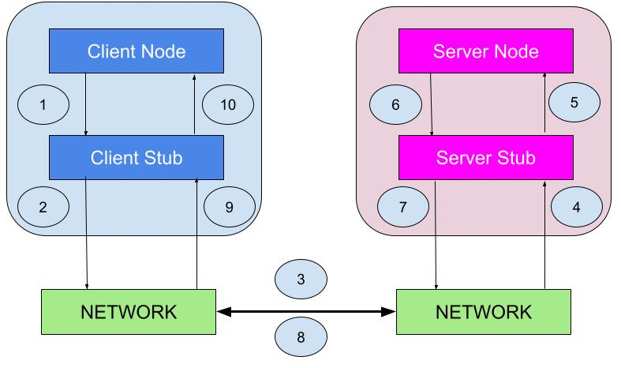
RPC
Client Node and Client Stub: The client node makes a procedure call, which is handled by the client stub. The stub packages the call into a message and sends it over the network.
Network: The network facilitates the transmission of messages between the client and server stubs.
Server Stub and Server Node: The server stub receives the message, unpacks it, and passes the call to the server node. The server node processes the request and returns the result back through the server stub, which then sends it back over the network to the client stub.
Client Node: Finally, the client stub receives the response, unpacks it, and delivers it to the client node.
Notes:
This slide explains the flow of an RPC (Remote Procedure Call) between the client node and server node through the network, focusing on the role of client stubs and server stubs. Here’s a breakdown of the process:
Client Node: The client makes a procedure call, but this is handled by the client stub.
Client Stub: The stub takes the procedure call, packages it into a message, and sends it over the network to the server.
Network: Facilitates communication between the client stub and server stub.
Server Stub: Receives the message from the client, unpacks it, and forwards the request to the server node.
Server Node: Processes the request, performs the procedure, and sends the result back to the server stub.
Server Stub: Packages the result and sends it over the network back to the client.
Client Stub: Receives the response, unpacks it, and delivers it to the client node, completing the procedure call.
This architecture abstracts network communication, making it look like the client is calling a local function, but it’s invoking a function on the remote server.
------------------
Let's dive deeper into the stubs in RPC and how modern implementations like gRPC build upon this model.
Roles of Stubs in RPC
Client Stub:
The client stub acts as a proxy for the client-side of the communication. When a procedure is called on the client side, the client doesn’t directly communicate with the server.
Instead, the client calls a function in the client stub, which encodes the call (including parameters) into a message (this process is known as marshalling).
This message is then sent over the network to the server.
Server Stub:
On the server side, the server stub receives the request and decodes the message back into the function call format (known as unmarshalling).
It then invokes the actual procedure (function) on the server.
After execution, the server stub collects the results (if any), encodes them into a message, and sends it back to the client stub.
Network:
The communication is abstracted, so neither the client nor the server has to deal with the networking details. This makes RPC feel like a local function call even though it's happening across systems or processes.
How gRPC Improves upon Traditional RPC
gRPC is a modern, high-performance, open-source framework for Remote Procedure Calls (RPC), originally developed by Google. Here's how it enhances the traditional RPC model:
Protocol Buffers (Protobuf):
gRPC uses Protocol Buffers (protobuf) for serialization of structured data. This is a language-neutral, platform-neutral, and highly efficient way to encode data compared to the plain text format used in traditional RPC.
Protobuf allows the data (request/response) to be smaller and faster to transmit, optimizing both bandwidth and performance.
Streaming Support:
Traditional RPC usually follows a request-response model. gRPC, however, supports more advanced communication models like:
Unary RPC: Single request and single response.
Server-streaming RPC: The server can send multiple responses to a client’s single request.
Client-streaming RPC: The client sends multiple requests, and the server responds once.
Bidirectional Streaming: Both client and server can send a stream of messages to each other in real-time.
This allows for more efficient handling of long-running operations or streaming data.
HTTP/2:
Unlike traditional RPC, gRPC runs on HTTP/2, which allows for multiplexing (sending multiple streams of data in parallel over the same connection), full-duplex communication (both parties can send data simultaneously), and reduced latency compared to HTTP/1.1.
Cross-Language Compatibility:
gRPC enables seamless communication between different languages. For example, a Python client can communicate with a Go server. gRPC handles the translation between programming languages using protobuf definitions.
Built-in Authentication:
gRPC has built-in support for authentication mechanisms like SSL/TLS for secure communication, and it integrates with other authentication protocols such as OAuth2.
Code Generation:
gRPC provides automatic code generation for client and server stubs based on the defined .proto file (the contract or interface between client and server). This file specifies the methods, message types, and how communication should occur.
Benefits of gRPC over Traditional RPC:
Speed & Efficiency: Protobuf is more efficient than XML/JSON used in traditional RPC or REST.
Streaming & Asynchronous Calls: gRPC supports multiple streaming models, making it ideal for real-time data transfer (e.g., video streaming, financial transactions).
Cross-Platform: gRPC allows easy communication between services written in different programming languages.
Example of gRPC Process:
The client stub (generated from a .proto file) sends a request in a serialized protobuf format to the server using HTTP/2.
The server stub (also generated from the .proto file) receives the request, unmarshals the protobuf message, and invokes the corresponding procedure.
After executing the procedure, the server sends the result back to the client in a protobuf format, and the client stub unmarshals it to a usable response.
Summary:
gRPC offers a more efficient and scalable approach to remote procedure calls, particularly in microservices architectures, thanks to its use of HTTP/2, Protocol Buffers, and streaming support. These features make it particularly suitable for low-latency, high-throughput systems that need to communicate between services or across different languages.

Slide 56
gRPC
Initially created by Google in 2015
gRPC is a robust open-source RPC framework to build scalable APIs
Protocol Buffers as IDL for serializing structured data and define service interface [Instead of JSON]
Uses HTTP/2 as the protocol [Instead of HTTP]
‘Protoc’ is the compiler
Supports 10+ languages – C#.NET, C++, Dart, Go, Java, Kotlin, Node, Objective-C, PHP, Python, Ruby
Notes:
This slide provides a concise overview of gRPC, a high-performance RPC framework. Let's break it down:
Key Points about gRPC:
Created by Google in 2015:
gRPC is a modern open-source framework initially developed by Google to handle Remote Procedure Calls (RPC). It's designed for building scalable and efficient APIs.
Uses Protocol Buffers (Protobuf) as IDL:
Instead of using JSON, gRPC uses Protocol Buffers (Protobuf) for Interface Definition Language (IDL), which is more efficient for serializing structured data. Protobuf files define the structure of requests and responses, making them faster and lighter compared to JSON.
HTTP/2 Protocol:
gRPC runs on HTTP/2, which offers advanced features like multiplexing, flow control, full-duplex streaming, and header compression, significantly improving performance compared to HTTP/1.1.
Compiler: protoc:
The protoc compiler generates code for both client and server stubs based on .proto files. It automatically generates type-safe code in different languages from the Protobuf definitions, enabling seamless communication between different languages.
Multi-Language Support:
gRPC supports over 10 programming languages, including C#, C++, Dart, Go, Java, Kotlin, Node.js, Objective-C, PHP, Python, and Ruby. This makes it versatile and adaptable to different tech stacks, which is useful in microservices architectures where services are often built in different languages.
Why gRPC?
Efficiency: With Protobuf serialization and HTTP/2, gRPC is faster than REST APIs using JSON over HTTP/1.1.
Scalability: It can handle high-performance, low-latency communication between microservices and across different platforms.
Cross-Language: Enables seamless cross-language communication, which is essential in distributed systems.

Slide 57
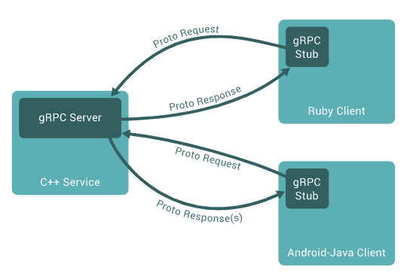
gRPC
Notes:
This diagram illustrates the gRPC communication model. It shows how a gRPC server can interact with multiple clients using different programming languages, all leveraging Protocol Buffers (Proto) for data serialization.
Key Components:
gRPC Server:
A service built in C++ that handles the actual business logic. It defines methods that clients can call remotely.
Clients:
Ruby Client: This client makes requests to the server using a gRPC stub, which is auto-generated code that helps in making RPCs.
Android-Java Client: Another client built with Java for Android, also utilizing a gRPC stub to make RPC calls.
gRPC Stub:
The stub on the client side takes care of sending the request and handling the response. It wraps the low-level details of the RPC communication, making it easier for developers to focus on business logic.
Communication Flow:
Proto Request:
Clients send a request to the gRPC server via a proto message, which contains serialized structured data.
Proto Response:
The server processes the request and sends a response back to the clients, again using Protocol Buffers for serialization.
Highlights:
Cross-Language Support: The gRPC server written in C++ can interact with clients written in Ruby, Java (Android), and many other languages, thanks to the platform-agnostic Protocol Buffers.
Efficient Communication: gRPC allows efficient client-server communication over HTTP/2 using binary serialization (Proto) rather than text-based formats like JSON, improving performance.
This design is highly scalable and commonly used in microservices architectures to enable low-latency, high-throughput RPCs.

Slide 58
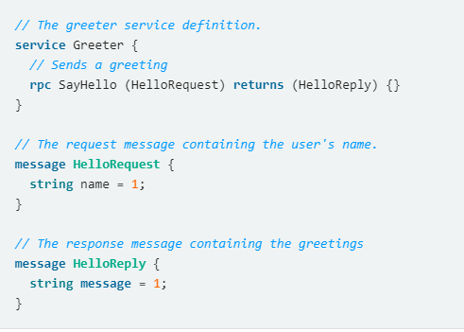
gRPC proto file [API definition]
Once we have defined gRPC proto file, we can use the “protobuf compiler – protoc” to generate code in our preferred programming language.
This generated code includes the classes and methods needed to create and parse the messages defined in the proto file, as well as client and server stubs that can be used to call the methods defined in the file.
By using gRPC proto, we can define our API in a language- and platform-neutral way, and then generate code for multiple programming languages.
Notes:
This slide provides an example of a gRPC proto file that defines an API using Protocol Buffers. Here's a breakdown:
Proto File Example:
proto
Copy code
// The greeter service definition. service Greeter { // Sends a greeting rpc SayHello (HelloRequest) returns (HelloReply) {} } // The request message containing the user's name. message HelloRequest { string name = 1; } // The response message containing the greetings. message HelloReply { string message = 1; }
Key Concepts:
Service Definition:
The Greeter service defines an RPC method called SayHello.
This method takes a HelloRequest message as input and returns a HelloReply message as the response.
Request & Response Messages:
HelloRequest contains a single field, name, which is of type string. This represents the user's name.
HelloReply contains a single field, message, which is also of type string. This will be the greeting message returned by the server.
Code Generation:
After defining the proto file, we can use the protobuf compiler (protoc) to generate client and server code in various programming languages such as Python, Java, Go, etc.
The generated code includes classes, methods, and stubs for clients and servers to handle RPC calls, parse the defined messages, and serialize/deserialize data efficiently.
Benefits of gRPC:
Platform-Neutral: The API is language-agnostic, meaning that the proto file can generate client and server code for multiple languages.
Efficient Communication: gRPC uses Protocol Buffers, which are smaller and faster than JSON or XML, making communication more efficient.
Scalable: This system allows building robust, scalable APIs that can handle high throughput, making it ideal for distributed systems and microservices architectures.

Slide 59
gRPC proto file for Calculator
syntax = "proto3";
package calculator;
service Calculator {
rpc Add (AddRequest) returns (AddResponse) {}
rpc Subtract (SubtractRequest) returns (SubtractResponse) {}
rpc Multiply (MultiplyRequest) returns (MultiplyResponse) {}
rpc Divide (DivideRequest) returns (DivideResponse) {}
}
message AddRequest {
int32 a = 1;
int32 b = 2;
}
message AddResponse {
int32 result = 1;
}
message SubtractRequest {
int32 a = 1;
int32 b = 2;
}
message SubtractResponse {
int32 result = 1;
}
message MultiplyRequest {
int32 a = 1;
int32 b = 2;
}
message MultiplyResponse {
int32 result = 1;
}
message DivideRequest {
int32 a = 1;
int32 b = 2;
}
message DivideResponse {
float result = 1;
}
Notes:
The image outlines the structure of a gRPC proto file for a Calculator service. The proto file defines the structure of the service and its operations, specifying how the client and server will communicate. Let's break it down:
Syntax and Package
syntax = "proto3";: This specifies the proto file uses the Proto3 syntax, the latest version of Protocol Buffers (protobufs).
package calculator;: This groups the defined messages and services under the "calculator" package.
Service Definition
The service Calculator block defines the gRPC service with four methods, each corresponding to basic arithmetic operations:
Add:
rpc Add (AddRequest) returns (AddResponse) {}: This defines the "Add" method, which takes an AddRequest and returns an AddResponse.
Subtract:
rpc Subtract (SubtractRequest) returns (SubtractResponse) {}: This defines the "Subtract" method.
Multiply:
rpc Multiply (MultiplyRequest) returns (MultiplyResponse) {}: This defines the "Multiply" method.
Divide:
rpc Divide (DivideRequest) returns (DivideResponse) {}: This defines the "Divide" method.
Each method allows a client to request a calculation and receive the result from the server.
Message Definitions
Messages are used to define the structure of the requests and responses for the gRPC service.
AddRequest:
This message contains two fields, a and b, both of type int32 (32-bit integer). These represent the two numbers to be added.
proto
Copy code
message AddRequest { int32 a = 1; int32 b = 2; }
AddResponse:
This message contains the result of the addition, with a single field result of type int32.
proto
Copy code
message AddResponse { int32 result = 1; }
Similarly, there are request and response messages for Subtract, Multiply, and Divide:
SubtractRequest and SubtractResponse: For subtraction.
MultiplyRequest and MultiplyResponse: For multiplication.
DivideRequest and DivideResponse: For division, with an additional float type to handle cases where the result might not be a whole number.
Summary
The Calculator service offers four arithmetic operations: addition, subtraction, multiplication, and division.
For each operation, a corresponding request and response message is defined.
These messages are serialized using Protocol Buffers (protobufs), a highly efficient data interchange format, which is more compact than JSON or XML.
This proto file allows you to generate gRPC client and server code for multiple programming languages, thanks to the protoc compiler, ensuring easy communication between distributed systems.

Slide 60
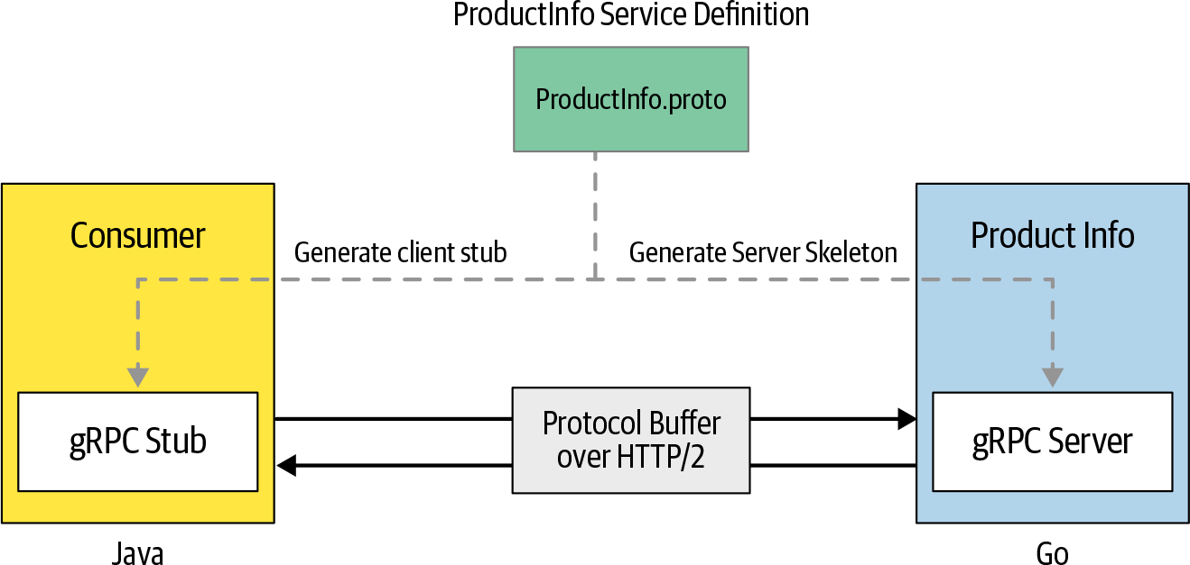
A microservice and consumer based on gRPC
Notes:
The image illustrates the structure of a microservice and a consumer based on gRPC technology.
Key Components:
ProductInfo.proto:
This is the service definition file written in Protocol Buffers (proto format). It defines the methods and data types for the gRPC service (in this case, the Product Info service).
The proto file is used to generate both the client stub and the server skeleton.
Client (Consumer):
The consumer (which could be any client service, in this case, represented by a Java client) generates a gRPC stub using the ProductInfo.proto file. This stub acts as a client-side interface to communicate with the gRPC server.
The client stub is used to make calls to the server by sending requests and receiving responses.
gRPC Server (Product Info Service):
On the server-side, the ProductInfo.proto is also used to generate the gRPC server skeleton (in this case, implemented in Go).
The server skeleton defines the methods that are called by the client and handles the business logic for the Product Info service.
Communication Mechanism:
Protocol Buffer over HTTP/2: The actual communication between the client and server is performed using Protocol Buffers (protobufs), a lightweight and efficient serialization format, transmitted over the HTTP/2 protocol.
The client sends a request to the gRPC server, and the server processes it and sends back a response using protobufs over HTTP/2.
Summary:
The proto file acts as a blueprint for generating both the client stub and server skeleton.
The client communicates with the server using gRPC and protobufs.
The interaction happens over HTTP/2, allowing for better performance, reduced latency, and features like multiplexing (sending multiple requests over a single connection).
This setup illustrates a typical microservices architecture where gRPC is used for communication between services, offering benefits such as high performance, support for multiple programming languages, and efficient data serialization with Protocol Buffers.
4o

Slide 61
A microservice and consumer based on gRPC
// ProductInfo.proto
syntax = "proto3";
package ecommerce;
service ProductInfo
{
rpc addProduct(Product) returns (ProductID);
rpc getProduct(ProductID) returns (Product);
}
message Product
{
string id = 1;
string name = 2;
string description = 3;
}
message ProductID
{
string value = 1;
}
Notes:
The image shows a proto file for defining a gRPC service called ProductInfo, which is part of an eCommerce system. This file is used to define the gRPC service, the RPC methods, and the structure of the messages exchanged between the client and server.
Key Components of the Proto File:
Syntax Declaration:
proto
Copy code
syntax = "proto3";
This declares that the proto file follows version 3 of the Protocol Buffers (proto3) specification.
Package Declaration:
proto
Copy code
package ecommerce;
The package defines a namespace for the proto file. It helps organize the code, especially in larger projects, by providing a unique namespace for the messages and services within the ecommerce package.
Service Definition:
proto
Copy code
service ProductInfo { rpc addProduct(Product) returns (ProductID); rpc getProduct(ProductID) returns (Product); }
Service Name: ProductInfo - This defines the name of the gRPC service.
RPC Methods:
addProduct: This method takes a Product message as input and returns a ProductID. It allows adding a product to the system.
getProduct: This method takes a ProductID as input and returns the corresponding Product. It allows fetching product details using the product ID.
Message Definitions:
proto
Copy code
message Product { string id = 1; string name = 2; string description = 3; }
This defines the structure of the Product message, which contains:
id: A string that uniquely identifies the product.
name: A string representing the name of the product.
description: A string for describing the product.
proto
Copy code
message ProductID { string value = 1; }
This defines the ProductID message, which is a simple message containing:
value: A string that holds the ID of the product.
Summary:
This proto file defines an eCommerce service for managing products. The service includes two RPC methods:
addProduct - for adding a product and returning its ID.
getProduct - for fetching a product's details based on its ID.
These methods exchange messages between the client and server in the form of Product and ProductID messages. The proto file helps generate code for both client-side stubs and server-side skeletons in multiple programming languages, making it easier to implement gRPC-based communication between services.

Slide 62
gRPC Advantages and Disadvantages
Advantages
It has simple, well-defined service interfaces and schema
It is polyglot (supports multiple languages)
Lightweight and Fast API
Best for Inter-Service Communication
Disadvantages
It may not be suitable for external-facing services
The support for gRPC in browser and mobile applications is still in the primitive stages [grpc-Web extension is available for limited browsers]
Notes:
This image highlights the advantages and disadvantages of gRPC, a Remote Procedure Call (RPC) framework.
Advantages of gRPC:
Simple and Well-Defined Service Interfaces: gRPC uses Protocol Buffers (protobuf) to define service interfaces and schemas, making the communication process clear and structured.
Polyglot (Supports Multiple Languages): gRPC supports more than 10 programming languages, including Python, Go, Java, and C++, making it versatile and compatible across different systems.
Lightweight and Fast API: gRPC uses HTTP/2 and Protocol Buffers, which are efficient in terms of speed and resource usage, resulting in faster communication.
Best for Inter-Service Communication: It is particularly suited for microservices architecture, enabling fast and secure communication between services.
Disadvantages of gRPC:
May Not Be Suitable for External-Facing Services: gRPC is optimized for service-to-service communication and might not be ideal for external-facing APIs (like those used by front-end applications or public APIs).
Limited Support for Browsers and Mobile Apps: Although gRPC-Web is available, support is still limited. Browser and mobile app support are in their early stages, with only a few browsers providing proper integration.
These points provide an overview of when and where gRPC can be beneficial and the current limitations in its application.

Slide 63
Demo - gRPC
Demo of “User” service with gRPC Server and gRPC Client implemented in C#. NET
Ref URL - https://grpc.io/docs/languages/python/quickstart/ for Python
Notes:
This slide demonstrates a gRPC demo featuring a "User" service where:
The gRPC Server and gRPC Client are implemented in C#.NET.
For a detailed tutorial and quickstart guide, the slide references the URL for Python implementations of gRPC at:
gRPC Python Quickstart
The demo is likely showcasing the setup and interaction between a server providing user-related services and a client consuming those services, both implemented using the gRPC framework.

Slide 64
Comparison

Slide 65
Comparison
Feature | Best API Type
Ubiquitous standard for Web | REST
Data Fetch | GraphQL
Browser Support | REST / GraphQL
Request Caching | REST
Code Generation | gRPC - Native support for 10+ languages GraphQL - GraphQL Code Generator [3RD party] REST – Swagger [3rd party]
Payload data structure | GraphQL - JSON REST - JSON & XML gRPC - Protocol Buffers
Notes:
This comparison chart provides an overview of the best API types for different features:
Ubiquitous Standard for Web: REST is the dominant API standard for web applications.
Data Fetch: GraphQL excels in efficient data fetching, as it allows clients to specify exactly what data they need, reducing over-fetching.
Browser Support: Both REST and GraphQL are well supported in browsers.
Request Caching: REST is typically better suited for request caching, especially with HTTP-based cache mechanisms.
Code Generation:
gRPC: Has native support for code generation in over 10 languages, making it ideal for strongly typed service-to-service communication.
GraphQL: Code generation can be achieved using third-party tools.
REST: Uses Swagger (OpenAPI) for code generation, but this is often third-party and less integrated compared to gRPC.
Payload Data Structure:
GraphQL: Uses JSON for data payloads.
REST: Supports both JSON and XML formats.
gRPC: Uses Protocol Buffers (protobuf), which are more efficient in terms of size and speed compared to JSON or XML.
This comparison can help in deciding the best API type for your use case depending on the requirements

Slide 66
API Versioning

Slide 67
API Versioning
API versioning is the practice of managing changes to an API and ensuring that these changes are made without disrupting clients.
A good API versioning strategy clearly communicates the changes made and allows API consumers to decide when to upgrade to the latest version at their own pace.
Why it is important?
When a third-party application developer uses your API to build an integration, they expect that the API will be stable. If you make changes to your API without considering clients, it forces them to change their own software. Otherwise, their applications could break if updates aren’t accounted for.
https://blog.hubspot.com/website/api-versioning#:~:text=What%20is%20API%20versioning%3F,version%20at%20their%20own%20pace.
Notes:
This slide focuses on API Versioning, emphasizing its importance for managing changes in APIs without breaking existing client integrations:
API Versioning: It refers to the process of managing changes in an API, ensuring that updates are backward-compatible or handled in a way that does not disrupt current users.
Good API Versioning Strategy:
Communicates changes to clients clearly.
Provides clients the flexibility to decide when they want to upgrade to the latest version, at their own pace.
Why is it Important?:
Stability: Third-party developers expect the API they integrate with to remain stable.
When changes occur without proper versioning or backward compatibility, these changes could force developers to alter their own systems, potentially breaking their applications.
API versioning ensures smooth transitions to newer versions, preventing service disruptions and helping developers maintain consistent integrations.

Slide 68
API Versioning
When to version API?
Costly (Cost and Effort) for API Consumers and Developers
Best to consider in case of breaking change – change in API that causes client applications to fail
Breaking changes are:
Changing the format of request or response data (like switching from JSON format to XML format)
Changing the data type of a resource (like changing from a string to an integer)
Changing the name of a resource
Removing one or more resources, removing or changing properties or methods for a particular resource, or any other changes to API functionality
Adding a new required field for client HTTP requests.
https://blog.hubspot.com/website/api-versioning#:~:text=What%20is%20API%20versioning%3F,version%20at%20their%20own%20pace.
Notes:
This slide further expands on API Versioning, focusing on when to version an API:
When to Version an API?
Versioning is costly both in terms of cost and effort for API consumers and developers.
The decision to version is usually made when there is a breaking change—a change in the API that would cause client applications to fail.
Breaking Changes (when versioning should be considered):
Changing the format of request or response data, e.g., switching from JSON to XML.
Changing the data type of a resource, e.g., changing a field from a string to an integer.
Changing the name of a resource.
Removing or changing resources or methods, which could affect how clients interact with the API.
Adding new required fields in HTTP requests that did not exist before.
Essentially, if changes in the API are going to disrupt the way clients interact with it, it's necessary to version the API to maintain backward compatibility. This ensures that older versions still function for users who haven't upgraded yet.

Slide 69
API - Semantic Versioning
Semantic Versioning is a versioning scheme for using meaningful version numbers.
A normal version number MUST take the form X.Y.Z where X, Y, and Z are non-negative integers, and MUST NOT contain leading zeroes.
X is the major version, Y is the minor version, and Z is the patch version. Each element MUST increase numerically.
Ex: 1.9.0; 2.11.1
Google Maps JavaScript API – Current Version is 3.54.4 (7-September-2023)
URL - https://developers.google.com/maps/documentation/javascript/releases#3.52.3
Notes:
This slide explains Semantic Versioning, which is a widely used versioning system for APIs and software to make version numbers meaningful and indicative of the type of changes made.
Key points:
Semantic Versioning follows the format X.Y.Z, where:
X represents the major version, which is incremented when there are breaking changes.
Y represents the minor version, incremented when new features are added but backward compatibility is maintained.
Z represents the patch version, incremented for bug fixes or small changes that do not affect backward compatibility.
Rules:
The version number must use non-negative integers and cannot have leading zeros.
Each element (X, Y, Z) must increase numerically as changes are introduced.
Example Versions:
Version 1.9.0 would indicate a major version of 1, minor updates in version 9, and no patch (or the first release of the feature set).
Version 2.11.1 indicates a major version of 2, minor version 11, and a patch level of 1, meaning a small bug or improvement was made to this version.
Real-world Example:
The Google Maps JavaScript API is given as an example, with its current version at 3.54.4 (as of 7 September 2023). This version indicates major version 3, minor version 54, and patch level 4.
A URL link to the release notes is also provided.
This versioning method helps developers understand the impact of changes at a glance and maintain compatibility across updates.

Slide 70
API - Semantic Versioning
Major version: In this approach, your URI would denote the breaking changes to the API. A new major version requires creating a new API. The version number is what you use to route to the correct host via your URI. Indicates incompatible API changes.
Minor version: You update change logs to inform API consumers of new functionality or bug fixes. It introduces a non-breaking functionality.
Patch versions: A patch is an update which is meant to fix existing bugs and it's backward compatible. It introduces non-breaking functionality.
Notes:
This slide further explains the different components of Semantic Versioning:
Major Version:
A major version increment indicates breaking changes to the API.
When you update the major version, it usually means the API's behavior is no longer compatible with previous versions, requiring developers to update their implementations.
Example: Moving from v1.x.x to v2.x.x typically requires a new endpoint or routing through a different URI to indicate a new API version, as the old version may no longer be supported or function the same way.
Minor Version:
A minor version update introduces non-breaking changes such as new features or bug fixes that maintain backward compatibility.
This means that users of the API don’t need to change their code if they don’t wish to take advantage of the new functionality.
Example: Incrementing from v1.2.x to v1.3.x adds functionality but doesn’t require clients to update their API interactions.
Patch Version:
A patch version is used for small bug fixes or other minor updates that don’t introduce any new features or changes that could break functionality.
This version increment signifies that it’s safe to upgrade without concern for breaking existing applications.
Example: Moving from v1.3.1 to v1.3.2 means bugs were fixed, but no new features or breaking changes were introduced.
Each version component serves as an indicator to API consumers about the level of change, helping developers manage dependencies and update APIs with minimal disruptions.

Slide 71
Semantic Versioning - Example
Example – API Versioning for Movies
Version 1.0.0: This is the initial release of the API. It provides basic information about movies, such as the title, director, release year, and plot summary.
Version 1.1.0: This version adds some new features to the API. For example, it may allow users to search for movies based on specific criteria, such as genre or actor.
Version 1.1.1: This is a patch release that fixes some bugs in the 1.1.0 version of the API. It doesn't introduce any new features.
Version 2.0.0: This is a major release that introduces significant changes to the API. For example, it may switch to a new data format or add new endpoints for accessing movie data. The new version may not be backward compatible with the previous version, so clients will need to update their code to work with the new API.
Version 2.1.0: This version adds some new features to the 2.0.0 version of the API, but still maintains backward compatibility with the previous version.
Version 2.1.1: This is a patch release that fixes some bugs in the 2.1.0 version of the API. It doesn't introduce any new features
Notes:
This slide offers a clear example of Semantic Versioning using a hypothetical API for movies. Here's a breakdown of how different version updates would occur in this context:
Version 1.0.0: This is the initial release of the API, providing essential movie data like title, director, release year, and plot summary. It establishes the foundation of the API and includes only the basic functionality.
Version 1.1.0: A minor version update that adds new features, such as allowing users to filter movies by genre or actor. This update adds functionality but remains backward-compatible, meaning existing API clients can continue using the API without any changes.
Version 1.1.1: A patch update that fixes bugs in the previous version (1.1.0), without introducing any new features. This is a non-breaking update that improves the stability or performance of the API.
Version 2.0.0: A major version update that introduces breaking changes. For instance, this might involve switching to a new data format or adding new endpoints, making the API no longer backward-compatible. Existing clients would need to update their code to interact with this new version.
Version 2.1.0: A minor version update to the major version 2.0.0 that adds more new features while maintaining backward compatibility. For example, this might extend functionality but allow clients who adopted version 2.0.0 to continue without breaking their integration.
Version 2.1.1: Another patch update for version 2.1.0, fixing some bugs without introducing any new features. This is a minor improvement to ensure stability.
In summary, the semantic versioning follows a structured path:
Major version changes (X) signify breaking changes.
Minor version changes (Y) add features in a backward-compatible manner.
Patch version changes (Z) fix bugs without altering functionality.

Slide 72
Semantic Versioning - Example
Each version of the API would be accessible through a specific endpoint, such as:
/api/v1.0.0/movies: Endpoint for accessing basic movie information in version 1.0.0 of the API.
/api/v1.1.0/movies/search: Endpoint for searching movies based on specific criteria in version 1.1.0 of the API.
/api/v2.0.0/movies: Endpoint for accessing movie data in version 2.0.0 of the API.
/api/v2.1.0/movies/search: Endpoint for searching movies based on specific criteria in version 2.1.0 of the API.
Notes:
This slide provides an example of how Semantic Versioning applies to API endpoints. Each version of the API corresponds to a unique endpoint, allowing different versions to coexist and be accessed independently. Here's the breakdown:
/api/v1.0.0/movies:
This endpoint is for version 1.0.0 of the API, which provides basic movie information, like titles, directors, and release years.
It's the initial version of the API.
/api/v1.1.0/movies/search:
This endpoint is for version 1.1.0, which introduces a new feature: the ability to search for movies based on specific criteria such as genre or actor.
It maintains backward compatibility, meaning clients using version 1.0.0 can still access their functionality without breaking.
/api/v2.0.0/movies:
This represents version 2.0.0, which introduces breaking changes—for example, a new data format or additional endpoints for accessing movie data.
Older clients using versions 1.x.x would not be compatible with this version without updating.
/api/v2.1.0/movies/search:
This endpoint is for version 2.1.0, which adds new features to the 2.0.0 version while keeping backward compatibility with it.
It enhances the movie search feature, allowing refined searches in this newer version.
In essence, each endpoint version lets developers control API functionality and allows users to transition smoothly between different API versions without breaking existing applications.

Slide 73
API Examples
[Self Study]

Slide 74
1. PetStore API
Swagger Petstore - OpenAPI 3.0
URL - https://editor.swagger.io/
Observe the JSON based API structure

Slide 75
2. Rapid API
World’s largest public API Marketplace
URL - https://rapidapi.com/
Explore the APIs

Slide 76
3. Conference API
R2: “Mastering API Architecture – Design, Operate and Evolve API-Based Systems”, by J.Gough et al., O’Reilly, 2023

Slide 77
Thank You!

